Slide 1
RCC Review: Rheumatology and MSK
Muhammed Dhalla
December 5, 2019

Slide 2
Objectives
2.1.18.1. Anatomy, structure and function of bone, joint and connective tissues, normal and abnormal
2.1.18.2. Physiology of normal bone growth and function
2.1.18.3. Recognition of non-inflammatory connective tissue diseases, e.g. Marfan's syndrome, Ehlers Danlos syndrome
2.1.18.4. Mechanisms of immune responses in rheumatic disease
2.1.18.5. Indications for, and interpretation of laboratory tests on blood and synovial fluid
2.1.18.6. Pharmacology of common anti-inflammatory drugs, corticosteroids and immunosuppressive drugs
2.1.18.7. Effects of chronic rheumatic diseases on physical growth and social development
2.1.18.8. Common radiographic abnormalities in musculoskeletal diseases
2.1.18.9.1. Congenital abnormalities
2.1.18.9.2. Joint and limb pain
2.1.18.9.3. Common fractures, dislocations or injuries
2.1.18.9.4. Joint deformities
2.1.18.9.5. Septic arthritis and osteomyelitis
2.1.18.9.6. Common gait disorders (limp, torsional and angular deformities of lower limbs)
2.1.18.9.7. Scoliosis
2.1.18.9.8. Acute / chronic arthritis
2.1.18.9.9. Systemic rheumatologic diseases, e.g. systemic lupus erythematosis, juvenile idiopathic (rheumatoid) arthritis
2.1.18.9.10. Bone tumors

Slide 3
2.1.18.9.9.
Systemic rheumatologic diseases
Broad categories of Rheumatologic Disease:
  “Autoimmune”
    Juvenile Idiopathic Arthritis
    Connective Tissue Diseases
      Systemic lupus erythematosus
      Juvenile Dermatomyositis
      Mixed / Undifferentiated connective tissue disease
    Vasculitis
      Systemic (large, medium, and small-vessel)
      Localized (cutaneous PAN, CNS vasculitis)
  “Autoinflammatory”
    Periodic Fever Syndromes
    Chronic Recurrent Multifocal Osteomyelitis (CRMO/CNO)
Notes:
Categories are not necessarily self-contained in reality, but for the purposes of the General Pediatrics royal college exam, they are divided in a manner similar to the above.
For example: overlap syndrome is a rheumatologic disease defined by simultaneously meeting criteria for multiple connective tissue diseases. Any of the diseases above can be characterized by chronic arthritis, but that does not necessarily designate them as having chronic JIA plus another disease (even if it MAY be treated as such).
General difference between Autoinflammatory and Autoimmune:
- Autoimmune engages (primarily) arms of the adaptive immune system (i.e. T and B lymphocytes) and is heavily centered around antibodies and TNF-a.
- Autoinflammatory engages (primarily) arms of the innate immune system (i.e. neutrophils, macrophages) and is heavily centered around IL-1 and the inflammasome.
Naturally these two categories are more of a spectrum, and in every disease both arms of the immune system play some role.

Slide 4
Juvenile Arthritis

Slide 5
2.1.18.9.9.
Systemic rheumatologic diseases
Juvenile Idiopathic Arthritis: Basic Definitions
  Arthritis: inflammation of a joint, characterized by an effusion, or by the presence of at least 2 of: swelling, erythema, painful range of motion/tenderness.
  Chronic Arthritis: arthritis lasting in a single joint for at least 6 weeks.
  Juvenile Idiopathic Arthritis: chronic arthritis with onset before age 16.
  Oligoarticular: involvement of no more than 4 joints within the first 6 months (accumulated).
    Can be classified as “persistent” if never more than 4, and “extended” if eventually includes more than 4 total joints.
  Polyarticular: involvement of at least 5 joints within the first 6 months
Notes:
Not all arthritis is JIA, nor is all chronic arthritis JIA.
Beyond 16 call RA
6 weeks for general diagnosis- 6 mo for a SUBTYPE

Slide 6
2.1.18.9.9.
Systemic rheumatologic diseases
Infectious
Mechanical
Differential Diagnosis
Septic Arthritis
Osteomyelitis
Transient Synovitis
Traumautic
Fracture
Hemarthrosis
Developmental
Slipped Capital Femoral Epiphysis
Legg-Calve-Perthes (AVN)
Osgood-Schlatter Disease
Sindig-Larsen-Johansson Disease
Inflammatory
Bone/Muscle
Reactive Arthritis
Post-Strep Reactive Arthritis
Viral Arthropathy
Juvenile Arthritis:
Juvenile Idiopathic
IBD-associated
CF-associated
Systemic Lupus Erythematosus
Vasculitis
Sarcoidosis
Malignancy
Bone (osteosarcoma, Ewings)
Muscle (rhabdomyosarcoma)
Synovium (PVNS)
Cerebral Palsy
Muscular Dystrophy
Notes:
Mechanical- most comon in hip and knee

Slide 7
2.1.18.9.9.
Systemic rheumatologic diseases
Classification:

Slide 8
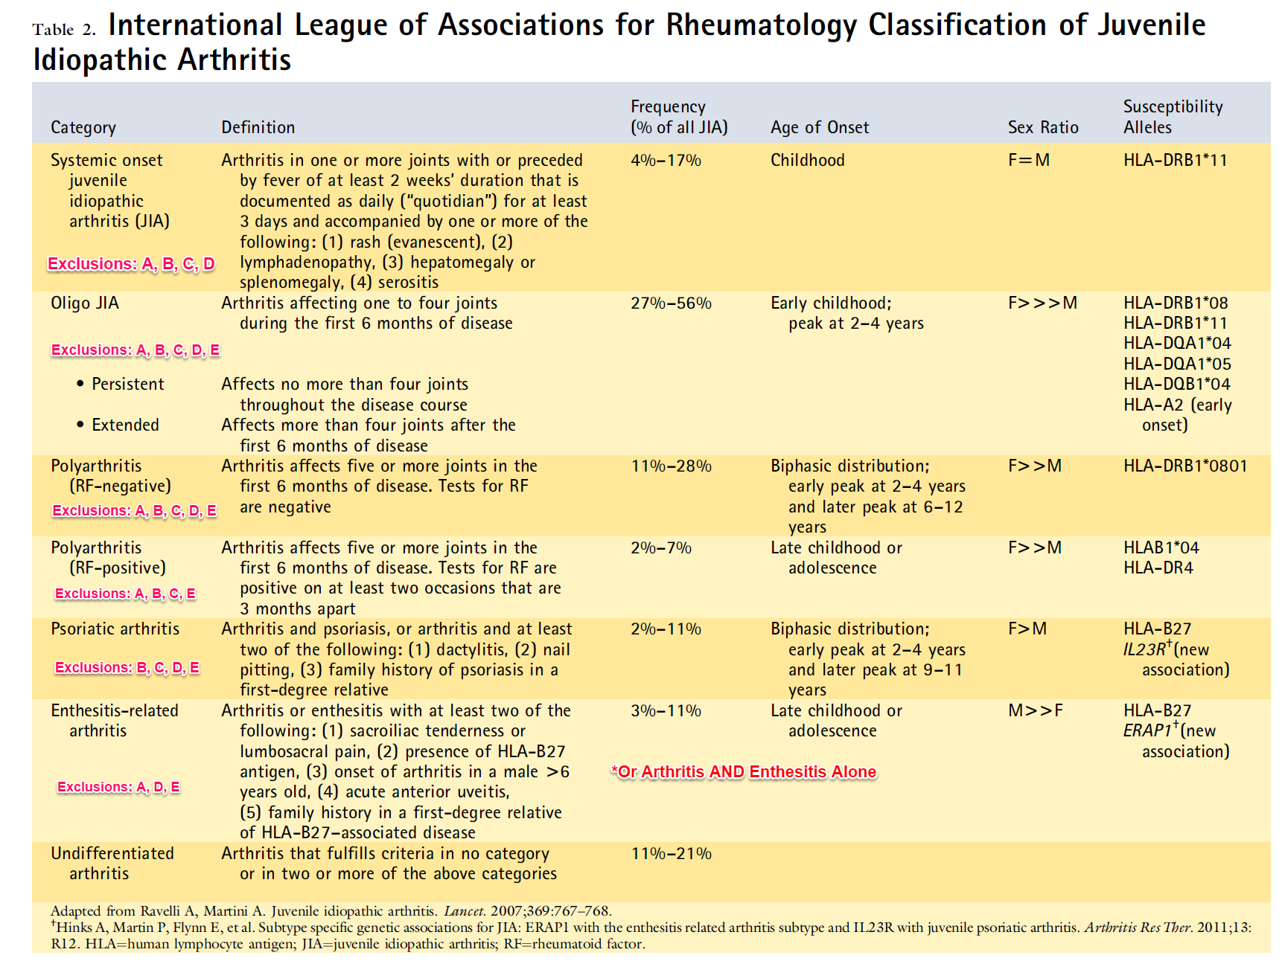
**Exclusions:
A) Psoriasis or history of psoriasis in patients or first-degree relatives (formally diagnosed).
B) Arthritis in HLA B27 positive males beginning after the age of 6 years.
C) Ankylosing spondylitis, ERA, sacroilitis with IBD, Reiter's syndrome, acute anterior uveitis, or history of any in first-degree relative.
D) Presence of IgM RF on at least 2 occasions 3 months apart.
E) Presence of systemic-onset JIA in patients.
Notes:
Most common= oligoarticular, peak 2-4 years
RF+= pediatric RA, most common in T21 and adolescent
Psoriatic arthritis: most poorly understood
Enthesitis related arthritis: plantar fascitis, lower back pain
Systemic Arthritis: by criteria you cannot diagnose with arthritis but functionally we all do

Slide 9
2.1.18.9.9.
Systemic rheumatologic diseases
Epidemiology:
  Incidence: 7-21 / 100 000 || Prevalence ~ 200 / 100 000
  ~ 10% systemic, 10% psoriatic, 10-15% ERA, 20% polyarticular, 40% oligoarticular
Multiple genetic markers associated with each of the different subtypes. Most important things to remember:
  HLA-B27 associated with enthesitis-related arthritis
  Other HLAs are associated with other subtypes of JIA
Notes:
ANA+= 15% healthy population
HLA-B27= 20%

Slide 10
2.1.18.9.9.
Systemic rheumatologic diseases
Presentation: depends on subtype (but strong similarities)
  Oligoarticular: typically presents with asymmetric large joint arthritis of a lower extremity (knee 89%, ankle 36%), usually in a young child (peak age 1-3 years).
  Polyarticular:
    RF positive: presents in adolescent females, typically with multiple joints simultaneously, usually as symmetric small joint.
    RF negative: bimodal peaks in childhood (1-3 years, F > M) and adolescence (F >> M)
  Psoriatic: bimodal peak in infancy (peak 3 years) where it mimics oligoarticular JIA, and in late childhood (10-14 years) where it mimics RF negative or ERA.
  Enthesitis-related arthritis: typically presents as either oligoarthritis of a lower extremity in a preadolescent male, or with chronic insidious lower back pain in an adolescent male (can affect both genders).
    Characterized by the presence of Enthesitis, or tenderness at entheseal insertions.
Notes:
Enthesitis: typically in males, insidious inflammatory back pain, HLA-B27 only + in 60-80%

Slide 11
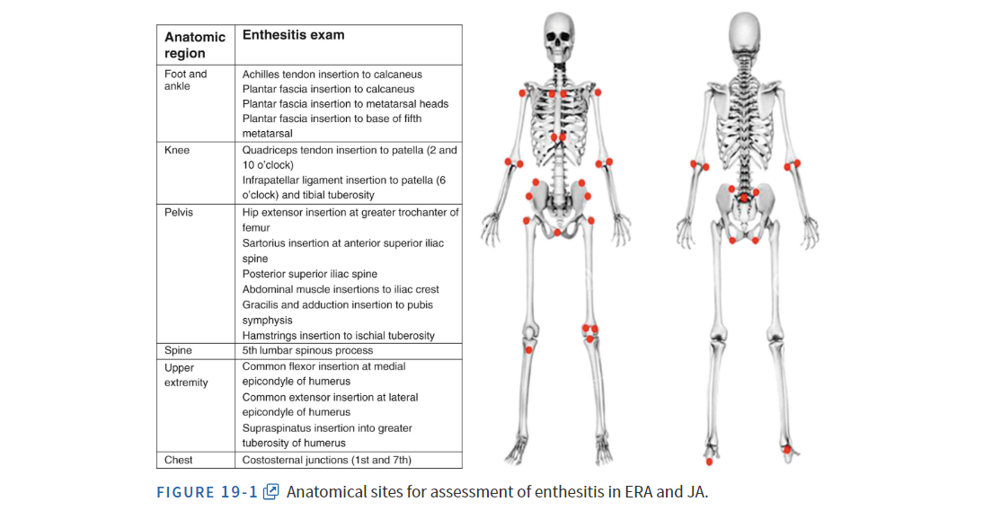
2.1.18.9.9.
Systemic rheumatologic diseases
Notes:
Knees
Feet
Classic plantar fascitis= tender at insertion points etc.--> may be enthesitis, should look at back

Slide 12
2.1.18.9.9.
Systemic rheumatologic diseases
Systemic JIA: will likely soon be reclassified as an autoinflammatory disease.
  Typically presents in early childhood (age 1-5 years) with fever and arthritis.
  Fever: Quotidien fevers (i.e. qD-BID, rapid rise / fall, high peaks above 39C)
  Arthritis: typically large joint polyarticular, but highly variable.
    Historically the most destructive arthritis when present, particularly in the hips.
    Arthritis present in ~ 90% at onset (compared to fever at 98%).
  Rash: evanescent (meaning comes and goes, usually with fever), salmon colored rash of varying distribution and symptoms. Non-vesicular. Occasionally urticarial.
  Other: lymphadenopathy, HSM, pleural effusion, hepatitis, pericarditis.
  Macrophage Activation Syndrome: a severe potential complication of sJIA most easily distinguished by extreme hyperferitinemia and hepatitis. Will discuss later.
Notes:
Note: for systemic arthritis the FIRST thought must always be malignancy and infection. It is almost impossible to distinguish between these entities without testing, and multiple cases of concordance are described for infection and sJIA or malignancy.
- For infection, consider EBV, CMV, parvovirus, arboviruses, malaria, and a host of other illnesses (in addition to common bacterial and toxic shock syndrome). Consider co-treatment while awaiting diagnosis.
- For malignancy, at minimum consider ordering peripheral blood smear (for blasts) and consider oncology consult. In some US institutions they will REFUSE to make a diagnosis of sJIA without a marrow.
- Most important ways to suspect malignancy over sJIA:
--- Are the platelets normal or high – normal platelets in active inflammation are inappropriately low and suggest malignancy and progressive marrow failure.
--- Severe “bone” tenderness – bone pain is typical of malignancy; often in leukemia a joint may be swollen, but allodynia of the affected area suggests malignancy.
CRITERIA: need fever for 3 days within a 2 week period
EVANESCENT SALMON COLORED RASH
DDx: EBV, CMV, malignancy (PBS, lactate)

Slide 13
2.1.18.9.9.
Systemic rheumatologic diseases
Presentation: What defines inflammatory joint pain?
  Worse in the morning, improves throughout the day.
  Worse with rest and better with activity.
  Stiffness tends to be worse than pain, and may cause functional issues.
  Symptoms tend to be either constant or ebb and flow over weeks (i.e. several weeks of symptoms, then few weeks of no symptoms).
    IE the patients who have pain a few nights a week here and there are not JIA
  Involved joints tend to follow certain patterns, at least in many cases.
Notes:
BONE TENDERNESS→ leukemia*****
Biggest differential between leukemia and systemic JIA is PLT (high in JIA, low in leukemia)

Slide 14
2.1.18.9.9.
Systemic rheumatologic diseases
Major complications:
  MSK: chronic (untreated) arthritis leads to growth asymmetry* and leg length discrepancy, short stature, chronic deformity, chronic osteoarthritis, and osteoporosis (and subsequent fracture risk).
  Uveitis: most important associated complication of JIA; accounts for up to 40% of all childhood uveitis, and occurs in 10-15% of all children with JIA (30% of oligo)
    In majority of cases is ASYMPTOMATIC until complications develop.
    Ultimate complication is blindness: on the way there, can develop keratopathy, synechiae, glaucoma, cataracts, and cystoid macular edema.
  Other: poor joints lead to poor sports participation and social exclusion, which can have numerous metabolic and mental health effects throughout childhood.
Notes:
Note: the affected limb will grow to be LONGER than the unaffected one. In children with open physes, inflammation leads to increased vascularization around the growth plate which leads to early and exaggerated growth of the affected limb. It will (over time and without treatment) cause early maturation of the affected joint, culiminating in advancement of bone age and premature closure of the physis (which can lead to asymmetric growth or eventually having the affected limb shorter). When this develops surgery ends up being the only options for management.
The main exception in uveitis is ERA – in this disease, particularly when patients are HLA-B27 positive, the uveitis is typically symptomatic. We sometimes refer to this as “iritis” though technically that term is synonymous with “uveitis”. This condition is typically highly responsive to topical steroids, and presents as an acute red, painful, photophobic eye. It rarely has long-term complications because, being symptomatic, patients present early for ophthalmologic care and are treated early and aggressively to prevent complication.
MSK Complications:
Longer leg is the one moer affected (more blood flow because of growth plates), flexture contractures, chronic osteo, osteoporosis

Slide 15
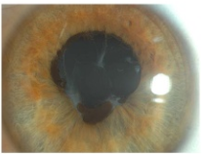
Notes:
Note: Uveitis can present prior to the onset of JIA, and almost all children with uveitis are referred to rheumatology for evaluation. This can be the first sign of JIA and should be screened for as part of regular child health surveillance (or at least the complications of it – which is to say LOOK AT THEIR EYES every now and then).
LOOKS LIKE A COLOBOMA
Synechiae

Slide 16
2.1.18.9.9.
Systemic rheumatologic diseases
Investigations (2.1.18.5. Indications for, and interpretation of laboratory tests)
  ANA: is a risk factor for uveitis in the context of JIA.
    ANA does not change the risk of JIA whatsoever; whether titer is 1:40 or 1:4000, the likeliehood of JIA is unaffected.
    ANA in high titers may suggest the presence of a connective tissue disease such as SLE. In teenage females it is helpful to consider whether SLE should be thought of.
  Rheumatoid Factor: unlike adults, 95% of children have RF negative disease. Should order it in adolescents or those with polyarticular small joint disease.
    RF is only positive if it persists for beyond 3 months. There are many causes of transiently positive RF, most commonly infection.
  HLA-B27: is seen in 10% of the HEALTHY population; given the incidence of JIA is low, a positive HLA-B27 affects post-test probability but does not give a diagnosis. It is used for classification and risk stratification.
  Bloodwork for work-up: ANA, RF, HLA-B27, celiac screen, CBC, albumin, ESR/CRP, iron studies (for IBD arthropathy), TSH, FT4
Notes:
As an antibody, RF can be seen in multiple CTD (particularly sjogrens and SLE). Therefore it’s presence does NOT preclude another diagnosis.
HLA-B27 is an independent risk factor for symptomatic iritis – patients who are positive for HLA-B27, irrespective of other diagnoses, should be counselled to seek out ophthalmologic care if they were to develop symptoms of acute iritis (including an acute, red, painful, photophobic eye). It is typically suggested they have annual eye exams.
Another test not mentioned above is Lyme Disease Serology: Lyme is extremely rare in Alberta, so routine testing is not required. It is one of the most common infectious causes of chronic monoarthritis, and is indistinguishable clinically from oligoarticular JIA. If there is travel to a high risk environment, a known tick-bite, or other symptoms suggestive of Lyme, then testing should be done.
Another test not mentioned above is Tuberculosis Testing: Tuberculosis is very well know to cause chronic arthritis and/or osteomyelitis. As above, it is rare in Alberta. In those with travel to/from high risk countries or with exposures, TB should be considered – initially via skin / serology / CXR, and potentially via joint aspiration.
BLOODWORK:
- ANA, RF, HLA-B27, celiac disease

Slide 17
2.1.18.9.9.
Systemic rheumatologic diseases
Investigations: Joint aspiration and Injection.
  Joint aspirate is NOT part of the work-up for juvenile arthritis; it is done when considering alternate conditions as a way to rule them out.
  The most common (and in common practice, only) reason to consider a joint aspiration is to rule out septic arthritis – i.e. in the context of acute arthritis.
    Most often seen in adult medicine, because gout is a common differential and on exam can be indistinguishable from septic arthritis.
  In the context of chronic arthritis, a joint aspirate is rarely necessary or helpful.

Slide 18
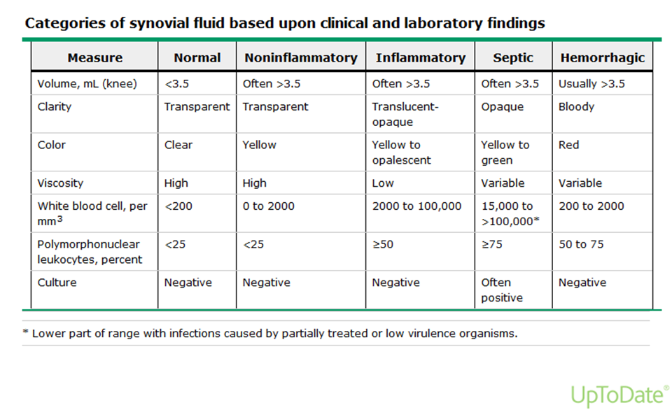
2.1.18.9.9.
Systemic rheumatologic diseases
However… because they like to ask it sometimes…
Notes:
I would consider this LOW YIELD and would not commit it to memory. I cannot promise it will NOT appear on your exam (given the objectives) but it is done so rarely in clinical practice (and when done is usually done by orthopedics or ER) that memory is better spent elsewhere.

Slide 19
2.1.18.9.9.
Systemic rheumatologic diseases
Management:
  Corticosteroid Injection: direct injection with steroid (typically TA) results in rapid improvement or resolution of arthritis, with effects lasting 3-24 months. Is rapid and inexpensive.
  In younger children, will require sedation. Will only target the joints you choose (i.e. will miss subclinical joints). Can make infections worse if wrong diagnosis.
  Complications can include local / cosmetic, infection, bleeding, anesthesia.

Slide 20
2.1.18.9.9.
Systemic rheumatologic diseases
Management
  NSAIDs: inhibit COX, which converts arachidonic acid into proinflammatory molecules (prostaglandin, thromboxanes, prostacyclins).
  Most commonly recommend Naproxen because T^{1/2} allows for BID dosing. Anti-inflammatory treatment requires high doses in a sustained manner.
  Naproxen: 15-20 mg/kg/d divided BID for at least 2 months
  Ibuprofen 30-40 mg/kg/d divided TID or QID for at least 2 months
  Celecoxib 50-100 mg daily or BID for at least 2 months.
  Adverse effects are uncommon and usually preventable. Can see dyspepsia/GI ulcer, renal injury, and pseudoporphyria.
Notes:
GI bleed rare in healthy patients; can start NSAID alone and if patient takes with food and still develops dyspepsia, then can Rx a PPI. Alternatively can Rx Vimovo (combination pill).
Renal injury is typically only seen in those who overdose or those who become acutely dehydrated. Patients should be counselled to have optimal hydration and to hold doses if they develop GI illness with vomiting / diarrhea.
Pseudoporphyria primarily described with naproxen and is very rare, and preventable with the regular application of sunscreen. Though it resembles freckles, it is permanent.

Slide 21
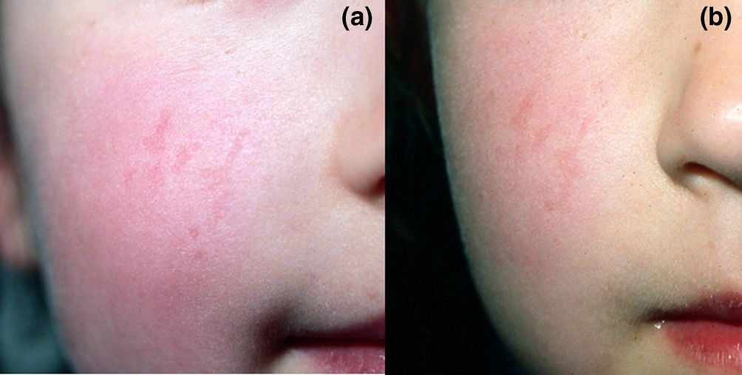

Slide 22
2.1.18.9.9.
Systemic rheumatologic diseases
Management:
  Systemic Corticosteroids: highly effective for short term management, extremely poor long-term monotherapy. Long list of adverse effects. Will sometimes be used to induce remission while awaiting proper treatment.
  **Please do NOT use without d/w rheumatology, as it will mask/treat joints**
  Methotrexate: Disease modifying anti-rheumatic drug (DMARD). First line therapy for all extensive JIA or disease refractory to NSAID/injection. Used in low doses – is well tolerated, safe, and efficacious in 80% of patients.
  Adverse effects include immunosuppression (minor degree), transaminitis (reversible in vast majority), GI intolerance / oral ulcers (manageable). Is extremely teratogenic while using it. Should avoid alcohol.
  Cannot have LIVE vaccinations per current recommendations.
  Other DMARDS: Leflunomide, Sulfasalazine, Thalidomide, +/- Plaquenil.
Notes:
Methotrexate will always be given with folic acid, as it is shown to decrease risk of hepatitis, GI intolerance, and oral ulcers. Can be given as 1 mg daily or 5 mg once or twice weekly (or more potentially). For no good reason or evidence, we tell them not to take the folic acid on the day of methotrexate. There is no good reason for this, but we all do it, so I can’t explain it unfortunately, except to say people would call it the “standard of care”.
Methotrexate can be given orally or subcutaneously, and is always given once per week. In theory and when compared head to head, there does not seem to be a major difference. At higher doses (> 17.5 mg) there does seem to be decreased and variable oral bioavailability, so anecdotally at higher doses SC tends to give better efficacy (no evidence supporting it). Also anecdotally there seems to be less GI intolerance with SC forms, though this may be a placebo effect.
Methotrexate induced nausea is a very real thing, and anticipatory nausea is the plague of rheumatology. If children are getting nauseated with methotrexate and are untreated, they will almost always develop anticipatory nausea that generalizes, and will often become non-compliant and refuse to take it again. If your patient on methotrexate is getting nauseated in the 24 hours after their dose (or even worse, BEFORE their dose), they should be advised to call rheumatology and (if not already given) take their ondansetron LIBERALLY. We recommend in ANYONE with nausea that persists into the AM, or anyone who has it prior to medication, take a dose of ondansetron 1h before their methotrexate and up to 2 doses 8 hours apart after if they are nauseated (PRN). Preventing methotrexate-induced anticipatory nausea is one of the greatest therapeutic challenges in JIA today.
MTX: immunsuppression, hepatitis, mucositis/oral ulcers, (take folate)

Slide 23
2.1.18.9.9.
Systemic rheumatologic diseases
Management: Biologics
  Biologics are a category of synthesized antibodies that range from fully-human to chimeric. Within each category they share adverse effect profiles.
  The most common ones to be aware of are the Anti-TNF agents, which include:
  Enbrel (Etanercept) / Erelzi
  Remicaide (Infliximab)
  Humira (Adalimumab)
  The main differences are in method of delivery (IV vs. SC), frequency (q1w-q8w), and immunogenicity (ability to induce other autoimmune disease).
  Main adverse effects are immunosuppression (moderate risk), latent disease reactivation (hepatitis/TB), injection/infusion reaction, demyelinating disease*, and autoimmune disease*
  Cannot have live vaccinations.
Notes:
Demyelinating diseases very rare but also very well described – manifests as AIDP (similar to Guillan Barre) or CIDP. No clear evidence, but thought to be higher risk in those with strong family history of MS.
Other induced autoimmune diseases vary, but most common are psoriasis and drug induced lupus.
All patients on a biologic should be / will need to be screened for TB prior to initiation. Patients with risk factors should be screened for hepatitis B/C.

Slide 24
2.1.18.9.9.
Systemic rheumatologic diseases
Management: Other Biologics
  Rituximab: anti-CD20, used in refractory arthritis and SLE
  Abatacept: anti-CTLA4, used in refractory arthritis
  Anakinra: anti-IL1R antagonist, used in systemic JIA, MAS, fever syndromes.
  Canakinumab: anti-IL1 agent, used in systemic JIA and fever syndromes.
  Tocilizumab: anti-IL6 agent, used in systemic JIA and refractory polyarticular JIA

Slide 25
2.1.18.9.9.
Systemic rheumatologic diseases
Management: Role of the Pediatrician:
  Encourage families to follow directions for regular labwork. Ensures complications can be caught early and prevented.
  See patients on immunosuppressants who have fever – may need throat swab, cultures, and consideration for empiric antibiotics.
  Encourage those on methotrexate to use double contraception and avoid / abstain from alcohol.
  Do not prescribe sulfa antibiotics to those on methotrexate.
Notes:
“Should I hold Methotrexate/Enbrel?”
No consistent, evidence based answer. Every rheumatologist is different.
General mentality is as follows: these drugs have a long-half life. It is unlikely that skipping a dose will affect overall level of immune function, or that giving a dose will impact it greatly. That said, the same logic also dictates that missing a single dose will not cause disease to flare. Because of (appropriate) risk aversion, most rheumatologists will recommend skipping a dose of any immune-suppressing agent (DMARD/biologic) if patient is unwell enough to warrant antibiotics. If suspicion of viral is so likely as to not give antibiotics, then can give dose. Equally reasonable to hold single dose or call rheumatologist on-call.
Rheumatic drugs may require adjustment for severe illness and surgery. Patients who are admitted on rheumatologic drugs for any reason should have rheumatologist called:
- NSAIDs may need to be held up to 48 hours prior to surgery
- DMARDS / biologics may need to be held for up to 1-2 weeks before surgery
- corticosteroids may need to be INCREASED for adrenal insufficiency depending on dosing / duration and illness severity.

Slide 26
Related conditions

Slide 27
2.1.18.9.9.
Systemic rheumatologic diseases
Septic Arthritis: acute monoarthritis (usually), most often caused by gram positive organism such as Staph or Strep. Consider K. Kingae as a gram negative organism, seen in up to 10% of cases. Other organisms based on risk factors. Typically will be acute in onset with a hot, red, swollen joint and accompanying systemic illness. Diagnosis ideally through joint aspiration for fluid and culture and blood counts. Etiologic agent only found in 2/3 of cases. Managed with antibiotics and aspiration / drainage. \
Transient Synovitis: Most often a condition of the hip, and primary differential for young children with limp. Typically less painful (can weightbear with difficulty) and less systemically unwell. Use the Kocher criteria to distinguish between TS and septic arthritis.
Notes:
Kocher Criteria:
(1) Non-weight bearing on affected side, (2) ESR > 40, (3) Fever > 38.5C, (4) WBC > 12 000
Likliehood of SA: 1 = 3%, 2 = 40%, 3 = 93%, 4 = 99%.
SEPTIC ARTHRITIS: red, hot joint

Slide 28
2.1.18.9.9.
Systemic rheumatologic diseases
Lyme Disease: read the CPS statement! Arthritis is a “late disease” manifestation, typically manifesting ~ 4 months after tick bite (though can be seen sooner). Is indistinguishable from oligoarticular JIA – usually a monoarthritis of a knee; joint fluid typical for inflammation not infection, and spirochetes not seen on joint fluid in general.
Diagnosis through serologic testing in at-risk individuals. Always ask about a history of tick exposure / travel to Lyme endemic areas.
Even with treatment, a significant minority can have chronic inflammatory arthritis and ultimately a diagnosis of JIA.
Chronic Lyme Disease: this is not a thing; do not refer this to us. Please.

Slide 29
2.1.18.9.9.
Systemic rheumatologic diseases
Reactive Arthritis: currently this term encompasses several former diagnoses: typical reactive arthritis, Reiter syndrome, and post-strep reactive arthritis:
  Typical: the typical description of reactive arthritis is a peripheral arthritis involving one or several joints that follows a few weeks after an infection with a dysentery-like illness (salmonella, yersinia, etc…). Other agents include chlamydia and mycoplasma. Can also cause dactylitis and enthesitis. Will see elevated inflammatory makers; joint fluid similar to inflammatory. Typically resolves within few weeks to months, and can be managed with NSAIDs. Some proportion go on to have chronic or recurrent arthritis and may be reclassified as JIA/ERA. Sulfasalazine favored over methotrexate.
  Reiter Syndrome: described a triad of arthritis, conjunctivitis/uveitis, and urethritis. No longer an independent term.
Notes:
Non-strep reactive arthritis: normally from travellers diarrhea (back pain, hip pain, knee pain, swollen joints)
Post-strep arthritis
Chlamydia

Slide 30
2.1.18.9.9.
Systemic rheumatologic diseases
Post-Strep Reactive Arthritis: a peripheral arthritis that follows soon after a GAS infection (typically < 10 days). Is additive, typically lasting ~ 2 months, with some cases lasting up to 6 months or having recurrences. Has been associated with erythema nodosum in some cases. Has moderate response to ASA / NSAIDs, but is typically self-limited. Throat swab often positive given the latency from diagnosis. Management is NSAIDs.
Rheumatic Fever: a systemic disease typified by carditis, arthritis, and typical rash. Usually occurs several weeks after strep infection. Diagnosis is clinical using the Jones Criteria. Key note is the arthritis is migratory and highly responsive to ASA and NSAIDs. Treatment is supportive and with antibiotics (clearance -> prophylaxis).
Notes:
Diagnosis: Jones Criteria were in 2015 (AHA) - stratified risk based on population (low risk population = incidence < 2 / 100 000 school-aged children / prevalence < 1 / 100 000 all age rheumatic heart disease).
Can diagnose Primary ARF with 2 major OR 1 major / 2 minor, and Recurrent ARF with 2 major OR 1 major / 2 minor OR 3 minor.
(A) Evidence of preceding GAS infection [*not required if presentation is chorea].
(B) Major Criteria: Carditis, Arthritis, SQ nodules, Erythema marginatum, Chorea.
For Low-risk populations, only polyarthritis is accepted as "major"; for non low-risk will accept polyarthralgia, or any number of joints (i.e. monoarthritis).
(C) Minor Criteria: Arthralgia, Fever, elevated inflammatory markers, prolonged PR interval [*varies by population risk].
Low-risk: polyarthralgia, fever (> 38.5), ESR > 60, CRP > 30, prolonged PR.
Non-low: arthralgia (any number), fever (> 38), ESR > 30, CRP > 30, prolonged PR.
Prolonged PR interval may not be used as a minor if carditis is used as a major; same is true for arthralgia.

Slide 31
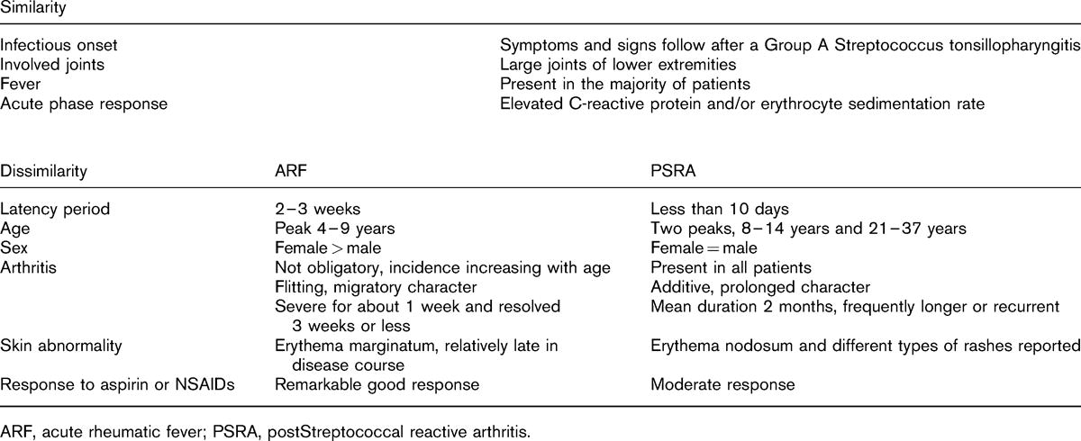

Slide 32
2.1.18.9.9.
Systemic rheumatologic diseases
IBD-Associated Arthropathy: one of the most common extraintestinal manifestations of CD > UC. Most common manifestation is arthropathy and arthralgias without true arthritis. 2 major patterns are described:
  Peripheral: this tends to follow a pattern of oligoarticular JIA involving large, more proximal joints (though can involve any / all joints). Follows the course of the disease and management is by improving control of underlying CD. If arthritis like this flares, it is likely there is a subclinical CD flare in the bowel.
  Axial: this tends to mimic ERA / AS, and is more common in those who are HLAB27 positive. Tends to be independent from IBD course and often requires treatment independent of IBD (though treatments tend to overlap).
CF-Associated Arthropathy: seen in up to 8% of patients with CF. Typical presentation is transient arthritis lasting 1-10 days with full resolution and relapses. NSAIDs usually sufficient.
Celiac Disease: It is known that celiac patients can have an inflammatory arthropathy that responds to GFD; however, also higher risk of JIA. If there is likely JIA, should screen for Celiac, and if positive, treat before diagnosing JIA formally.

Slide 33
Systemic Lupus

Slide 34
2.1.18.9.9.
Systemic rheumatologic diseases
The prototypic autoimmune disease, caused by a loss of Tolerance.
An antibody mediated disease (at it’s most simple level of comprehension).
  There are some subtypes of “congenital” SLE that are related to direct defects in the complement pathway.
  The most common of these is homozygous anti-C1q deficiency, wherein 90% of affected patients will have SLE. Also seen in C2 and C4 deficiencies.
Typified by the Anti-dsDNA Antibody (more antibodies will be discussed).
Typified by involvement of skin, blood/marrow, and kidneys in majority.
Unlike adults, pediatric SLE tends to have more frequent / severe organ manifestations, less commonly has sicca symptoms / arthritis, and can have a more defined genetic basis.
Notes:
Outside your scope, but helpful to understand, is the current model of understanding for the pathogenesis for lupus.
In summary, lupus is felt to be a disease of the host system gone “awry”, by losing central and/or peripheral tolerance.
- Defects in apoptotic clearance results in presentation of intracellular matter (recall that antigen clearance and antigen segregation are 2 forms of peripheral tolerance) to antigen presenting cells. These cells process and present “self’antigens through the immune cascade and cause an antibody response to the self-cells that presented the original intracellular matter. Because intracellular matter is DNA, which is found in ALL cells, SLE can affect any / all organs.
- Neutrophil NETs may also play a role, as an innate and normal form of intracellular presentation (and an innate lack or loss of tolerance allows for this hypothesis to be independent of an inciting trigger).

Slide 35
2.1.18.9.9.
Systemic rheumatologic diseases
Classification Criteria*
ACR Criteria (for classification) - most recently modified in 1997. Classification requires any 4 criteria, and has a 76.6% sensitivity, and 93.4% specificity in children.
  Malar rash (fixed erythema, flat or raised, sparing nasolabial folds)
  Discoid rash (raised erythematous patches with keratotic scaling and follicular plugging)
  Photosensitivity (rash from exposure to sunlight)
  Oral or Nasopharyngeal ulceration (usually painless)
  Arthritis (non-erosive, involving at least 2 peripheral joints)
  Serositis (pleuritis, pleural effusion, pericarditis, pericardial effusion)
  Renal disorder (proteinuria > 0.5 g/d, or cellular casts)
  Neurologic disorder (seizures or psychosis, without other explanation)
  Hematologic disorder (hemolytic anemia, leukopenia (< 4.0), lymphopenia (< 1.5), or thrombocytopenia)
  Immunologic disorder (dsDNA, Sm, LAC, ACl, or false positive RPR)
  Positive ANA
Notes:
It is important to know that these are Classification Criteria. Distinct from diagnostic criteria. Classification criteria are set out to define a similar set of patients (for the purposes of studies) that in this care are conveniently called SLE. You can be diagnosed with SLE having 0-1 of these manifestations only, though this is extremely rare. The most common case of this is biopsy-proven glomerulonephritis – this criteria, independently, confers as diagnosis of systemic SLE, even if the entire work-up is negative.
Disease manifestations can evolve over time. It is always important to do a detailed review of systems in patients with SLE, noting that EVERY manifestation has a common differential that is more likely than active SLE. The patient must be taken as a whole. Screening labs are regularly performed to evaluate evolution of silent / subclinical disease, particularly hematologic and renal.
Alternate classification criteria: DO NOT LEARN THESE. Added them purely so you can understand the scope of SLE and how different groups weigh different features.
SLICC Criteria (for classification) - published 2012 by European cohort primarily. Classification requires 4 criteria, at least one from each category, and has 98.7% sensitivity and 85.3% specificity in children.
Clinical:
Acute cutaneous lupus (malar, bullous, TEN, maculopapular, photosensitive, subacute cutaneous)
Chronic cutaneous lupus (discoid, localized/generalized, hypertrophic, profundus, mucosal, tumidus, Chillblains)
Oral ulceration (palate, buccal, tongue, nasal)
Alopecia (non-scarring; diffuse thinning with fragility)
Synovitis (involving at least two or more joints)
Serositis (pleurisy, pleural rub, effusion, percardial pain, pericardial rub, effusion)
Renal (protein:creatinine ratio > 500 mg/24h, or RBC casts)
Neurologic (seizures, psychosis, mononeuritis, myelitis, cranial neuropathy, acute confusional state
Hemolytic anemia
Leukopenia (< 4, at least once) or Lymphopenia (< 1.0)
Thrombocytopenia
Immunological:
ANA (any level above reference range)
dsDNA (above reference range, or 2-fold if ELISA)
Smith (any level above reference range)
Antiphospholipid antibody (LAC, ACl, B2GP, or false-positive RPR)
Low complement (C3, C4, CH50)
Positive Coombs test (in absence of hemolytic anemia)

Slide 36
2.1.18.9.9.
Systemic rheumatologic diseases
Epidemiology:
  Incidence ~ 1 / 100 000; Prevalence ~ 2-25/100 000
  Typical (pediatric) age of onset in early adolescence (5:1 F to M ratio)

Slide 37
2.1.18.9.9.
Systemic rheumatologic diseases
Typical Manifestations: The ACR criteria are common manifestations.
  Systemic: fevers, malaise, fatigue, lymphadenopathy, weight loss.
  Rashes: malar, photosensitive, discoid, others (many types; any rash can be SLE), oral / nasal ulceration.
  Sicca Symptoms: dry mouth (excessive cariogenesis), dry eyes (ulcerations).
  MSK: myositis, arthralgia, arthritis (typically non-erosive, symmetric, small joint).
  End-Organ:
    Neuropsychiatric (seizures, psychosis || anxiety, depression, headaches*)
    Cardiopulmonary (effusions, hemorrhages, endocarditis)
    Vascular (vasculitis, Raynaud phenomenon)
    Thromboembolic (stroke, coronary sinus venous thrombosis, DVT/PE) – related to APLs
    Glomerulonephritis (5 subtypes; affects 20-75%, with 20-50% developing ESRD).
Notes:
Above is a good demonstration of why classification criteria and diagnostic criteria are different.
Systemic manifestations are among the most common manifestations of SLE, but are not included in the ACR criteria. Similarly, the most common manifestations of NP SLE (of which there are at least 17) are headaches, anxiety, and mood disturbance; however, the most SPECIFIC are seizures and psychosis, hence their inclusion in classification.
SLE is one of the most common acquired causes thrombophilia outside of obvious causes (i.e. line placement). Keep in mind that children do not really get primary antiphospholipid syndrome (not the least of which is that you cannot meet criteria for it without recurrent pregnancy losses). In reality > 50% of those with APLs that are real will end up having / developing features of SLE.
Classification of GN: You probably do not have to know this.
Classification: 2 major systems - WHO and ISN/RPS; preferable to use latter as it was to supplant the WHO as it includes measures of acuity and chronicity. Classification requires light microscopy, immunofluorescence, and electron microscopy.
Class I: Minimal Mesangial - mesangial immune deposition seen on IF (normal LM).
Class II: Mesangial proliferative - mesangial hypercellularity/expansion (on LM), mesangial immune deposition.
Class III: Focal proliferative - segmental or global GN of< 50% of glomeruli, with focal subendothelial deposits.
Subclassified as A (focal proliferative), A/C (focal proliferative and sclerosing), or C (focal sclerosing)
Class IV: Diffuse - diffuse, segmental or global GN of > 50% of glomeruli, with diffuse subendothelial deposits.
Subclassified as S (diffuse segmental; IV-S) if > 50% of glomeruli have segmental lesions (< half of glomerular tuft), or G (diffuse global, IV-G) if > 50% have global lesions (> half of glomerular tuft).
Further subclassified as A, A/C, or C (i.e. 6 total classes)
Class V: Membranous - global or segmental subepithelial deposits (on LM); may occur with class III or IV.
Class VI: Advanced sclerotic - > 90% of glomeruli globally scarred, without residual activity

Slide 38
2.1.18.9.9.
Systemic rheumatologic diseases
Note on Cutaneous Lupus: it is seen in pediatrics, and does not necessitate a referral to rheumatology in all cases.
Myriad of cutaneous manifestations of SLE, most of which can be seen in systemic and cutaneous SLE.
  Malar rash, photosensitivity, discoid, tumid, subacute cutaneous, RP
  Bullous, livedo, vasculitic, alopecia, oral/nasal ulcers.
The first half of these are seen in both systemic and cutaneous, while the latter are seen in systemic (or in other conditions).
In general if you have a patient with isolated cutaneous features:
  Do full set of SLE labs (will discuss shortly)
  Refer to Dermatology for biopsy to confirm
  If anything positive on labs – refer to rheumatology; if work-up negative, consider repeating annually or as needed and refer if becomes positive.

Slide 39
2.1.18.9.9.
Systemic rheumatologic diseases
Investigations: Antibodies
  ANA: Highly sensitive, poorly specific. Excellent screening tool.
    99% of patients will be positive for ANA (usually at titer above 1:80, not always).
    Up to 20% of healthy pediatric population positive for ANA at 1:40-1:80.
    This means you only order an ANA if you suspect SLE* – if it is negative there is almost NO reason to refer / work-up further, unless there is a manifestation so pathognomonically SLE that you suspect false negative (GN, APLS, etc…)
  dsDNA: Highly sensitive and extremely specific. Excellent diagnostic tool.
    Will be positive in > 90% of SLE (bit less than ANA though); < 5% of SLE patients negative with active disease. Can be used as a marker of activity in some patients.
  ENA: The types of ANA. Each ENA is associated with certain manifestations of disease, and can be seen in other diseases as well. In general this can be interpreted by the rheumatologist if positive (though please only order it in the correct context, as it is notorious to have low titer false positives).*
Notes:
ANA is not JUST see in SLE, it is seen in majority of CTD. These include JDM (up to 70%), Sjogrens (> 80%), Morphea, Scleroderma, MCTD, UCTD, and Overlap syndrome.
The main reason I put “only for SLE” above is for simplicity, but also for realism: SLE Is a hard disease to diagnose given the myriad of manifestations. Almost anything CAN be SLE, but most things aren’t SLE, so ANA is good here. The other CTDs above have very clear manifestations, or BETTER tests (i.e. CK/LDH for JDM, Ro/La for Sjogrens). In those cases, a negative ANA may mislead you into NOT referring, so doing the test can cause more harm than good.
For the purposes of a GENERAL pediatrician I would recommend this:
- If you think someone may have SLE, or you want to rule it out, you can consider an ANA. If the titer is low positive (1:40-1:80), in real life, call the rheumatologist on-call who can advise additional testing and may avoid referral. If titer is high (>= 1:160), complete the SLE work-up and refer to Rheumatology as semi-urgent. If there are organ manifestations like renal we will admit and see same week. If rest of work-up negative, may take 3 months to see.
- If you think someone may have JIA, DO NOT ORDER AN ANA to help refer. We hate this referral and talk about you behind your back. You can order an ANA if you are doing other labs to save the child labwork, but then do the full gambit of a JIA work-up (including RF, B27, liver enzymes, celiac screen, thyroid screen) so you can justify saving them a poke. On your referral, put that you did an ANA to triage ophthalmology urgency, and have them seen an ophthalmologist within 1 month (possibly before seeing us) if ANA positive.
- If you think someone may have any other rheumatologic disease, you can order an ANA but do not let the result influence you in ANY WAY. If you think someone needs to be tested for CTD, order the better tests, or refer if your suspicion is clinical.
*The important ENA to be aware of is if the patient is Anti-Ro positive. This is the single antibody that predicts the risk of neonatal lupus, and risk can be 2-10% (mitigated to near-normal risk if treated with plaquenil). When you transition your patients to adulthood, it is EXTREMELY important to make note of their Ro and antiphospholipid status, as these have significant implications for pregnancy in terms of both maternal and fetal health.

Slide 40
2.1.18.9.9.
Systemic rheumatologic diseases
Investigations: Equally important:
  CBC: Any/all cell lines can be down; can mimic malignancy; can present as an isolated chronic ITP that later involves other cell lines.
  Creatinine, Urea, Urinalysis: The most important test for SLE; even more important than dsDNA/ANA, should always evaluate for renal disease if you ever mention the word lupus.
    Prefer a first AM sample to rule out orthostatic proteinuria.
    If positive can refer to nephrology and complete work-up as they await triage.
  Complements: Low C4 is notoriously common in SLE; Low C3 also common, but has a much broader differential so in isolation is harder to interpret.
  General chemistries: screening for end organ function, MAS, and differentials (malignancy, infection) depending on presentation.

Slide 41
2.1.18.9.9.
Systemic rheumatologic diseases
Management: Guided by the manifestations; Kidneys take priority.
  Corticosteroids: used almost universally in all types of SLE with end-organ disease. Topical used for cutaneous SLE. Not as helpful for systemic manifestations.
  Renal disease (excluding the uncommon class I/II) typically get steroid pulse.
  Cytotoxic Agents: used primarily for renal disease (class II-V), end-organ disease, or refractory manifestations.
    Cyclophosphamide: the best treatment for SLE in terms of length of study and efficacy. Many adverse effects, including nausea/vomiting, SIADH, hair loss, and long-term infertility (up to 10% in pubertal females). Gold standard for NPSLE. Advantage is it only needs to be given for 6 months (IV) then can switch to Imuran.
    Mycophenolate Mofetil: will likely be the universal gold standard in a few years, has shown non-inferiority to IV cyclophosphamide in even severe SLE, excluding NPSLE (because of low CNS penetrance). Given orally, and main AE are cytopenias and GI intolerance.

Slide 42
2.1.18.9.9.
Systemic rheumatologic diseases
Management: Other Agents.
  Plaquenil: The gold standard for maintenance therapy – used in almost every flavor and variety of SLE. Has been shown to decrease flare rates and severity of flares when they occur. Considered in many a life-long therapy. Only significant adverse effect is Bulls-Eye Maculopathy, which can develop in those taking it for more than 5 years, and presents as reversible loss of color vision. Can be detected prior to onset with ophthalmologic screening and reversed with adjustment or discontinuation of plaquenil.
  Sun Safety: UV light can trigger DNA release and cause an SLE flare, even in those without cutaneous disease. All patients with SLE should be counselled on sun safety / clothing, and to use sunscreen liberally and regularly.
  Rituximab: used mostly in refractory SLE or in isolated / severe hematologic SLE.
  Imuran: used for milder disease, particularly class I/II GN, systemic disease, cutaneous disease, or vasculitic disease. Also used as a maintenance agent and stepdown from cyclophosphamide. Main AE is cytopenia and intolerance. Can cause critical neutropenia in patients with TMPT deficiency.
  ASA: sometimes used alongside other agents in the management of APLA.
Notes:
You may notice that patients take plaquenil irregularly, 2-5 days per week. This is because it has a long half life, and because the pills only come as 200 mg (and though they can be crushed, they taste like liquid death mixed with kerosene. As a kindness to our patients, we calculate their suitable daily dose, multiply by 7, and divide it during the week into 200 mg doses.
- For instance, the typical dose for SLE is 3-6 mg/kg/d. In a 20kg patient I would want 60-120 mg / day. In a week this would be 420-840 mg; I would therefore choose ~ 600-800 per week, meaning they could take 3-4 doses of 200 mg per week. I would then Rx it as every other day, so they get 3x200 one week and 4x200 the next week. Alternatively I could just pick Monday – Thursday every week. No rhyme or reason.

Slide 43
Neonatal Lupus

Slide 44
2.1.18.9.9.
Systemic rheumatologic diseases
The prototype of a vertically transmitted autoimmune disease.
Is due to the passage of maternal anti-Ro antibodies across the placenta and into the fetal circulation. There are some fetal factors at play.
Is NOT a permanent condition; lasts as long as antibodies do. Typically the onset of manifestations will be in-utero (cardiac) and within first month or so (remainder) and will tend to fade over the course of 6 months along with antibodies.
  Some slightly higher long term risk for JIA and SLE, but low enough that a referral is not warranted for screening. We will discharge these patients after 1 year of life and they will be re-referred as any patient would be if they develop disease.
Most often, mothers do not know they have the pathogenic antibody (they may have subclinical disease). Always refer mother to rheumatology if baby has NLE formally diagnosed. Can prevent majority of manifestations with maternal treatment with plaquenil.

Slide 45
2.1.18.9.9.
Systemic rheumatologic diseases
Manifestations:
  Cardiac: Congenital Heart Block is the most common and severe manifestation of NLE, and the reason we attempt to diagnose and treat it.
    Can present as any degree of heart block, though third degree quite common.
    No good evidence that it progresses through stages; it is unclear.
    NLE accounts for > 90% of cases of congenital heart block.
    Risk of CHB in Anti-Ro positive mother is 1-2%; increases to 15% if previous baby CHB.
    Other manifestations (primary and as sequelae) are EFE and DCM. Mortality if these develop in childhood is > 10%.
    Screening protocols for mothers with Ro antibody are serial echocardiograms from weeks 18-30, with administration of tapering Dexamethasone from time of diagnosis to delivery at first sign of CHB (low FHR, abnormal echo). With severe low FHR, may add IVIG and Beta agonist (terbutaline, salbutamol)

Slide 46
2.1.18.9.9.
Systemic rheumatologic diseases
Manifestations:
  Cutaneous: typically manifests as discrete, round papules with fine scale. Usually annular and usually on the face and upper chest. More specific is the “racoon eyes”. May also see bullous, targetoid, or other lesions – ddx is broad.
    Rarely present at birth; peak onset ~ 6 weeks, resolution by 6 months (average 17 weeks of rash).
    Does not require any treatment. Can use topical steroids but is purely cosmetic. Should not scar.
  Hematologic: seen in up to 30%; most common is isolated thrombocytopenia (first week) or neutropenia (weeks 2-6), though aplastic anemia also seen.
    Self-limited and requires no treatment; if symptomatic, may consider IVIG / steroids.
  Liver: transaminitis seen in up to 25%; case reports of fulminant liver failure.
  Neurologic: Case reports of hydrocephaly / macrocephaly and seizures.

Slide 47
Juvenile Dermatomyositis

Slide 48
2.1.18.9.9.
Systemic rheumatologic diseases
Disease of chronic, progressive muscle inflammation that is (likely) based on small vessel vasculopathy / vasculitis.
Manifests with progressive proximal muscle weakness (not pain usually) that may result in corticobulbar weakness, and pathognomonic rashes.
Incidence ~ 0.02-3.2 / 1 million children; childhood peak 4-9 years, F > M.

Slide 49
2.1.18.9.9.
Systemic rheumatologic diseases
Manifestations:
  MSK Disease: Proximal muscle weakness, particularly hips and shoulders.
    In younger children, often manifests as motor regression; older is loss of ADLs.
    On exam will appreciate proximal muscle weakness (using MMT, Trendelenberg) and can be seen clinically by appreciating the Gower sign.
    Always ask about the Dangerous D’s (Dysphagia, Dyspnea, Dysphonia). If any are positive, they warrant an Urgent referral / admission and should be kept NPO.
    Other MSK manifestations include osteoporosis, arthritis (up to 65%), and contractures.
  Mucocutaneous Disease: Pathognomonic rashes (see next slides)
    Calcinosis is another common (?) manifestation, though in general can be hard to detect for non-rheumatologist and is usually a sequelae of chronic disease.
  Other:
    Lipodystrophy: loss of subcutaneous fat, accompanied by metabolic syndrome.
    Vasculopathy: GI vasculopathy ranges on a spectrum from abdominal pain to ischemic bowel (with perforation and ulceration described).
    Cardiopulmonary: With active disease may have weakness due to inflammation of intercostal muscles; with certain subtypes (Jo-1, MDA-5) can see ILD.

Slide 50
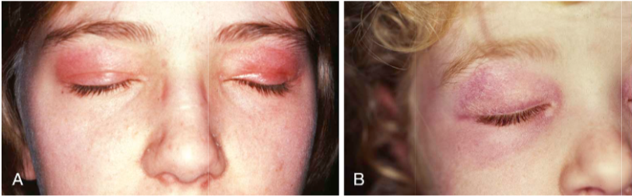
2.1.18.9.9.
Systemic rheumatologic diseases
Notes:
Heliotrope rash
Violaceous rash

Slide 51
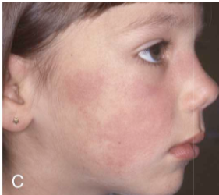
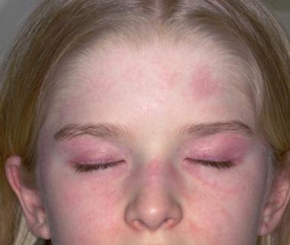
2.1.18.9.9.
Systemic rheumatologic diseases
Notes:
Malar Rash

Slide 52
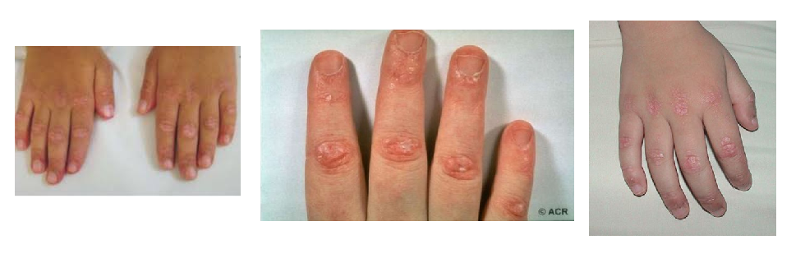
2.1.18.9.9.
Systemic rheumatologic diseases
Notes:
Gottrons papules

Slide 53
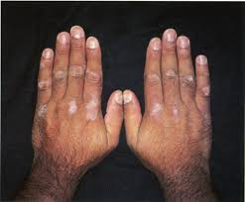
2.1.18.9.9.
Systemic rheumatologic diseases
Notes:
Gottron patch (aka hypopigmented / atrophic Gottron lesions)

Slide 54
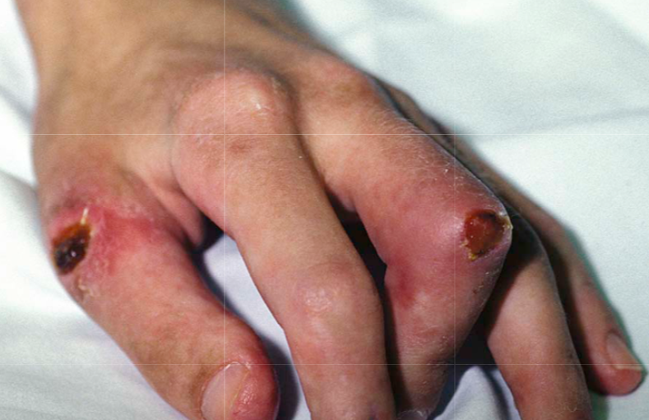
2.1.18.9.9.
Systemic rheumatologic diseases
Notes:
Ulcerative Gottron – severe manifestation, high risk of infection

Slide 55
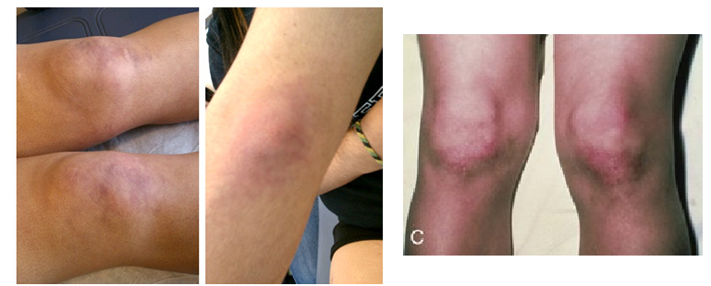
Juvenile Dermatomyositis
What is this?
Notes:
STILL GOTTRONS; note that it can be present on all extensor surfaces, but is typical over the hands

Slide 56
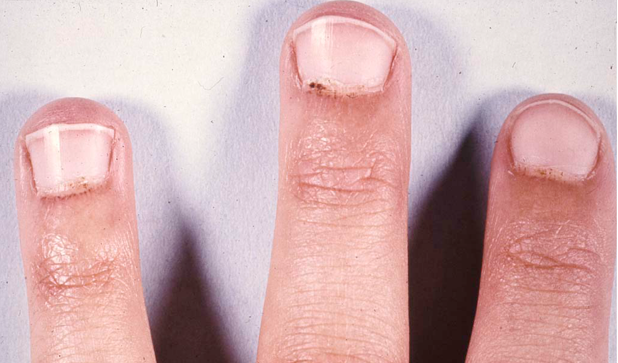
2.1.18.9.9.
Systemic rheumatologic diseases
Notes:
Periungual capillaropathy (note dilations on the rightmost finger) and erythema.

Slide 57
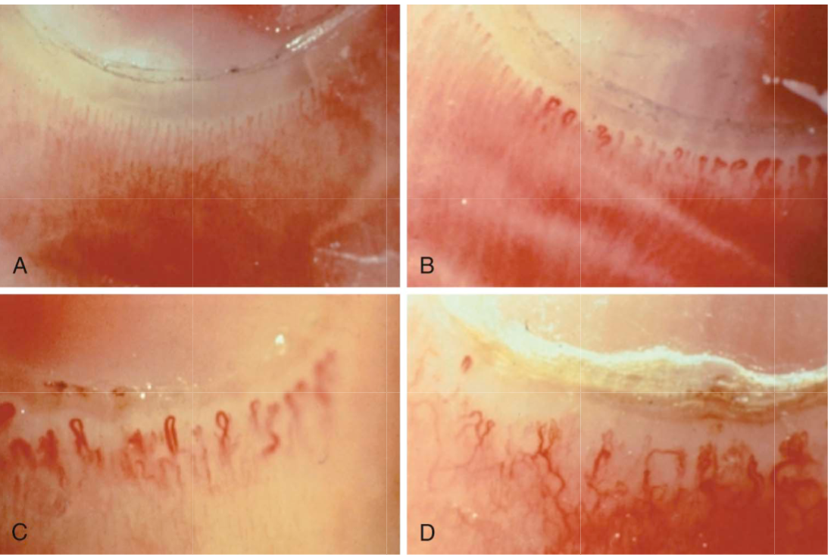
2.1.18.9.9.
Systemic rheumatologic diseases
Notes:
Progressive Periungual changes:
A – normal capillaries; nice and thin, lined up, equal spacing, small and relatively even gap from cuticle
B – dilatation and mild tortuosity of the “curvy” vessels. On right side, decreased capillary density (number of capillaries / 1 mm)
C – Significant tortuosity, some dropout (recession from cuticle, misalignment)
D – Total chaos with dropout, tortuosity, and neoangiogenesis leading to hemorrhage

Slide 58
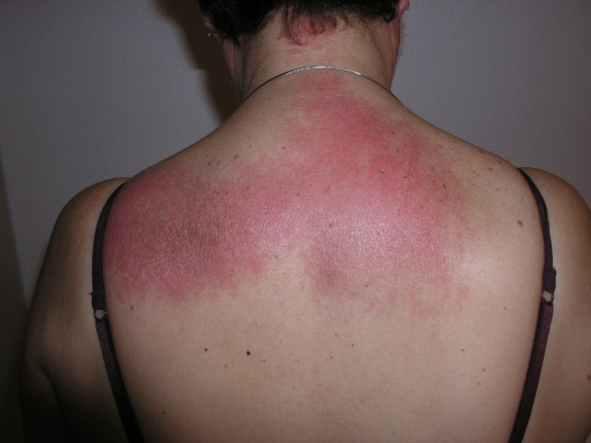
2.1.18.9.9.
Systemic rheumatologic diseases
Notes:
Shawl Sign

Slide 59
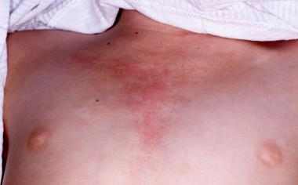
2.1.18.9.9.
Systemic rheumatologic diseases
Notes:
V-sign

Slide 60
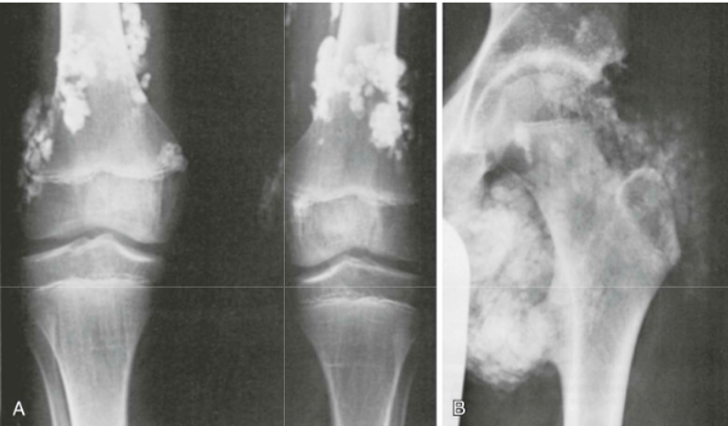
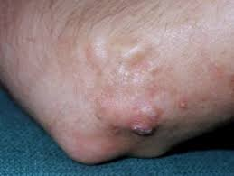
2.1.18.9.9.
Systemic rheumatologic diseases
Notes:
Calcinosis

Slide 61
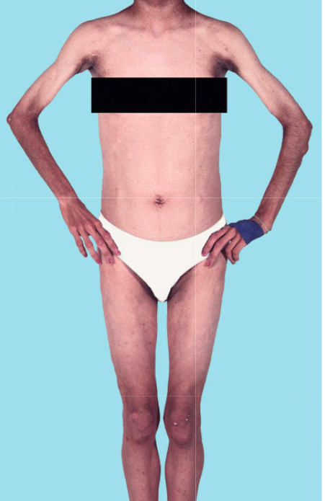
2.1.18.9.9.
Systemic rheumatologic diseases
Notes:
Lipodystrophy

Slide 62
2.1.18.9.9.
Systemic rheumatologic diseases
Bonham and Peter Diagnostic Criteria:
Symmetric proximal muscle weakness.
Characteristic cutaneous changes (heliotrope rash, extensor (Gottron) papules).
Elevation of CK, AST, LDH
EMG changes characteristic of myopathy and denervation (polyphasic/short/small motor potentials, fibrillations/sharp waves/insertional irritability, high-frequency repetitive discharges).
Muscle biopsy showing compatible findings (necrosis, fiber size variation, perifasicular atrophy, degeneration with regeneration, mononuclear inflammatory infiltrate).
MRI IS BEST DIAGNOSTIC TEST--> gold standard
Biopsy only done if no rash
Notes:
Notable for Absence of MRI; currently this is the gold standard for diagnosis and has replaced 4/5.
- EMG is done on occasion if there is a question of neuropathy or guillan barre on an equivocal MRI
- Biopsy is done to rule out JDM and rule in / diagnose muscular dystrophies
#2 is a mandatory criteria for clincal diagnosis (always pissed me off why it wasn’t, then, the number one criteria). Diagnosis can be made with 1-3 alone, though when available confirmation with MRI is always preferred. Non-contrast MRI of hip is standard in most places, but Toronto does shoulder, and some places including our own do limited whole-body.

Slide 63
2.1.18.9.9.
Systemic rheumatologic diseases
Investigations
  Muscle Enzymes: at least one is elevated in 80-98% of patients at time of diagnosis
    CK, AST, ALT, and LDH are main ones we order || Aldolase helpful but not done in most institutions
    CK typically elevated to the 1.5-15x range (contrast DMD typically much higher)
    Does not necessarily correlate with disease activity
    Can be falsely normal with progressive inactivity or severely delayed diagnosis
  vWF Antigen: marker of endothelial injury, and elevated in vasculopathy / vasculitis
    Is the best marker of disease activity and early flare (Guzman et al)
  Other Biomarkers: ESR > CRP; low complements on occasion; high IgG on occasion
  Other Rheumatology Things: ANA, dsDNA, ENA, UA, etc…
    ANA elevated in 40-70% || ENA positive in up to 75% (RNP, SSA, PM-Scl)
Notes:
Myositis-Specific Antibodies: likely beyond your scope, but is below to help you understand why we order it and what we are learning.
Evolving field of study; some disease correlation; elevated in ~ 50%.
TIF-1 gamma or P155/140 (23-30%): associated with extensive rashes, ulcerations, lipodystrophy (and in adults, malignancy).
NXP-2 (20-25%): associated with dysphonia, contractures, calcinosis, and ulceration (i.e. more severe disease).
Jo-1 (2-5%): prototypic antisynthetase antibody, associated with weakness, ILD, arthritis, and RP. High mortality.
Mi2 (2-13%): mild JDM with rashes and high CK; more common in Hispanics.
SRP (1%): acute and severe weakness, cardiac disease, and RP; refractory; more common in African-American girls.
MDA-5 (rare): rapidly progressive ILD, cutaneous ulcerations, and very high mortality.
SAE (0.2%): cutaneous manifestations primarily, cutaneous predate muscle symptoms, and absence of ILD.

Slide 64
2.1.18.9.9.
Systemic rheumatologic diseases
Key points in management:
  Disposition: JDM can be a medical emergency. Consider admission, NPO with IV fluids, 1:1 or 1:2 nursing care, and full CRM to assess cardiopulmonary weakness
    Remember that they may have respiratory muscle weakness; as such they may be unable to manifest tachypnea and will drop their minute ventilation rapidly. Strongly consider a baseline gas and reassess as needed to prevent need for intubation.
  Other Services: early involvement of OT/PT for rehabilitation, SLP for swallowing assessment (clinical determination), and nursing for support / care.
  General measures: Don’t forget sun protection in community – like with SLE, sun can trigger cutaneous disease, which can activate systemic disease.
  Corticosteroids: typically give a pulse in all but the most mild of cases, followed by a very slow taper. Very good evidence that tapering quickly (faster than 6 months) has higher likelihood of disease flare.

Slide 65
2.1.18.9.9.
Systemic rheumatologic diseases
Management:
  Methotrexate: Gold standard for the management of JDM, recommended in all cases that don’t require more aggressive treatment. Minimum of 2-3 years. SQ is preferred due to concerns of absorption with subclinical GI vasculopathy.
  IVIG: Gold standard for severe cutaneous disease; used in addition to methotrexate and steroids, not in lieu of.
  Cyclophosphamide: used for the more severe or refractory disease manifestations, particularly those requiring ICU admission or with progression while on methotrexate.
  Rituximab: considered at same level (or as next step, depending on algorithm) to cyclophosphamide; may be more useful in antibody-positive disease.
  Other: Anti-TNF biologics, Imuran, MMF, and Cyclosporine are all considered for multiple refractory disease states.

Slide 66
The Other CTDs

Slide 67
2.1.18.9.9.
Systemic rheumatologic diseases
Raynaud Phenomenon: can be primary (most common) or secondary. It is likely Raynauds if it is (1) induced by cold, and (2) results in a well demarcated area of biphasic color change (usually white -> blue -> red). In general RP affects fingers (+/- toes, noes, ears) asymmetrically, is well demarcated, and causes paresthesias. Occurs with relative change in temperature and with emotional distress. Can take 10-40 minutes to revert to normal when rewarmed.
Risk factors for secondary RP: male, young age, ANA, abnormal nailfolds.
Management: avoid vasoconstrictors (i.e. ADHD meds, smoking), core temperature maintenance, extremity warmth, “windmilling”.
Main DDx: Vasomotor instability / acrocyanosis, Erythromelalgia.
Notes:
Cold has to be a trigger→ then hand changes color when it is cold
Need to feel warm

Slide 68
2.1.18.9.9.
Systemic rheumatologic diseases
Sjogren Syndrome: typically manifests as dry mouth and dry eyes; very uncommon in pediatrics, and when present is often very atypical in presentation and picked up while screening for SLE. Serology is typically highly positive for ANA, RF, Ro, and La, and notably negative for dsDNA. Treatment is topical (drops, drinking water) +/- plaquenil in some.
Linear Scleroderma: see photos; typically manifests as a slowly growing patch of abnormal skin or subcutaneous tissue; usually manifests with skin hypopigmentation, and over time will develop loss of fat / muscle, atrophy of site, hyperpigmentation, and change in skin to a hard, shiny appearance. ANA often positive. Clinical + pathologic diagnosis. Treated with topical therapy, prednisone, and methotrexate.
Systemic Sclerosis: very rare; manifestations highly variable in childhood, but include sclerodactyly (tightening of skin around hands and mouth) and interstitial lung disease. Can also have arthritis as a common manifestation. Treatment depends on disease, but notably steroids are avoided, as it can cause renal disease.
Notes:
They are very unlikely to ask you about systemic sclerosis or sjogrens on exam; linear scleroderma is fair game

Slide 69
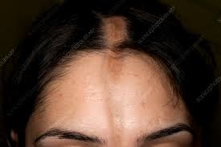
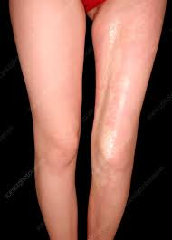
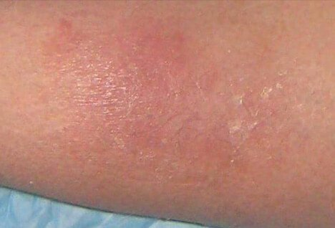
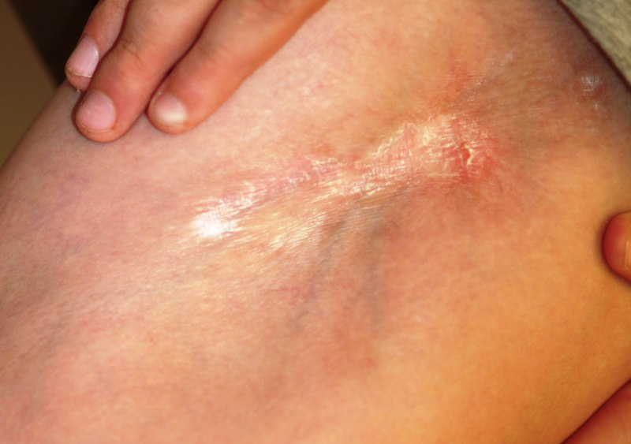
Notes:
Examples of linear scleroderma

Slide 70
2.1.18.9.9.
Systemic rheumatologic diseases
Mixed CTD: essentially is a diagnosis given to patients who have some features of multiple CTDs (usually combination of SLE, JDM, and RP) but who have abnormally high anti-RNP levels. Treated same as SLE.
Undifferentiated CTD: essentially MCTD without high levels of RNP.
Overlap Syndrome: when patient meets diagnostic criteria for more than one connective tissue disease.

Slide 71
Vasculitis

Slide 72
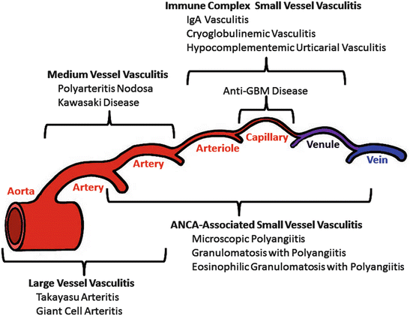
2.1.18.9.9.
Systemic rheumatologic diseases
Notes:
Current nomenclature based on the Chapel Hill Consensus (above) that delineates by vessel size. Not included are Regional Vasculitis that affect all vessel sizes within a single organ system. For our purposes, the only real example of this is CNS Vasculitis.
In terms of what is fair game, hard to imagine you ever getting a question on vasculitis on your exam. That said, the ones they may ask about would be Takayasus and GPA. You will definitely have a question on Kawasaki Disease and one on HSP.

Slide 73
Henoch-Schonlein Purpura

Slide 74
2.1.18.9.9.
Systemic rheumatologic diseases
The prototypical leukocytoclastic vasculitis, also referred to as IgA vasculitis).
Second-most common pediatric vasculitis (after KD); mean age 7 years.
Classification: PReS/EULAR criteria confer a sensitivity of 100% and specificity of 87%. Requires (A) and one of (B)
  (A) Palpable purpura, with a lower limb distribution (*if atypical distribution, MUST also have biopsy findings of B)
  (B) Any one of the following:
    Diffuse abdominal pain
    Arthritis or arthralgia
    Renal involvement (hematuria, proteinuria)
    Biopsy demonstrating leukocytoclastic vasculitis (skin) or IgA proliferative GN (renal)*

Slide 75
2.1.18.9.9.
Systemic rheumatologic diseases
Etiology: remains unclear; thought to be a reaction to an infection given seasonality is described, but multiple agents have been implicated.
Manifestations:
  Cutaneous: palpable purpura (95-100%), in dependent distribution (*don’t forget to check the buttocks). Lesions occur in crops, and can recur over the course of 6 months from diagnosis (though each episode less severe / shorter in duration).
  Gastrointestinal: abdominal pain (70%) or GI bleeds (30%) are most common. Typically occurs within 7 days of rash (always within 1 month; rarely precedes). Intussusception is seen, and can be a cause of either manifestation.
  Renal: glomerulonephritis seen in 30%; 20 % will have it at onset*
  Other: arthritis (50-80%; oligoarticular, transient), pulmonary hemorrhage, seizure, parotitis, scrotal edema, urethritis, carditis.
Notes:
Timeline of Glomerulonephritis:
20% at onset
85% by 4 weeks
91% by 6 weeks
97% by 6 months

Slide 76
2.1.18.9.9.
Systemic rheumatologic diseases
Investigations: not necessary for diagnosis (which is clinical) except for a CBC (need to prove purpura in presence of normal platelets).
  Inflammatory markers typically elevated
  IgA may be elevated in ~ 70% of cases (non-specific, not useful for diagnosis).
  ANCA should be negative; consider checking in atypical cases.
Management: In acute phase management is supportive care alone. Main management is to monitor for development of renal disease, and refer to nephrology if proteinuria / hematuria develop.
  Corticosteroids are useful for short-term relief. Can improve arthritis and abdominal pain. If giving Rx, should do 1 mg/kg/d, tapering over 4 weeks (otherwise symptoms return).
  Steroids do not influence the development of GN.
  NSAIDs can be used for arthritis, depending on severity of bowel involvement.
Notes:
1st 4 weeks: weekly
Then net 5 months MONTHLY
HSP does NOT cause testicular torsion
IF going to be on steroids need to do it for a minimum 3 weeks
Clinical diagnosis- may do a CBC because you have to have purpura without low PLT

Slide 77
Kawasaki Disease

Slide 78
2.1.18.9.9.
Systemic rheumatologic diseases
The most common vasculitis of childhood, involving small-to-medium vessel with a predilection for coronary arteries.
Everything you need to know is in the updated AHA 2017/2018 guidelines.

Slide 79
2.1.18.9.9.
Systemic rheumatologic diseases
Diagnosis: Requires (A) and at least 4/5 (B)
  (A) Fever for > 5 days (4 if IVIG eradicates fever)
  (B) Any 4 of the following:
    Bilateral nonpurulent bulbar conjunctivitis (80-90%)
    Oropharyngeal changes (80-90%) - red/fissured lips, strawberry tongue, pharyngeal erythema
    Extremity changes (80%) - erythema / edema (acute phase), desquamation (convalescent phase)
    Polymorphous rash (>90%) - nonvesicular (AHA clarifies to maculopapular, erythroderma, or EM like)
    Cervical LN (50%) - at least one node > 1.5 cm.
Notes:
Other Features:
Pulmonary (pleural effusion > nodules, infiltrates)
Urinary (sterile pyuria, urethritis > hematuria, proteinuria, orchitis)
CNS (irritability, lethargy, SNHL, aseptic meningitis > seizure, stroke, palsy)
GI (diarrhea, vomiting, gallbladder hydrops, hepatomegaly > intestinal hemorrhage, perforation, jaundice, pancreatitis)
Hematologic (anemia, thrombocytosis, leukocytosis > thrombocytopenia, coagulpathy, MAS)
Uncommon hematologic features are poor prognostic markers.
MSK (arthritis > raynaud phenomenon); may be oligoarticular or polyarticular.
Cardiac (tachycardia, myocarditis, pericarditis > CAA, aortic root dilatation/rupture, valvulitis)
Myocarditis occurs in 33-50% of patients to some degree, usually manifesting as an S3 gallop. Only rarely does this progress to CHF. If treated, no long-term damage.
Shock syndrome occurs rarely; manifest as systolic hypotension, often with decreased LVEF and CA abnormalities. Often resistant to IVIG alone.
CAA occur in 25% of those untreated; with IVIG, decreases to ~ 2%. Typically develop in acute or early in subacute phase; rare to evolve 2 weeks after fever ends.

Slide 80
2.1.18.9.9.
Systemic rheumatologic diseases
Diagnosis: Incomplete KD - Requires use of an algorithm based on above criteria.
  Diagnosis may be made in the presence of (A) and 2-3 (B) if the following scenario are met:
  Elevated ESR (40) / CRP (30) and at least 3 supplementary criteria* confirm diagnosis
    *Anemia, albumin < 31, elevated ALT, sterile pyuria, leukocytosis, thrombocytosis (after day 7)
    *Positive echocardiogram (alone) is sufficient
  If ESR/CRP not high enough, clinical observation warranted; if high enough, check labs and treat accordingly.
  Incomplete KD is alternatively diagnosed in any patient with fever and any feature, who then develops CA dilatation. In infants < 6 months, consider with fever alone.

Slide 81
2.1.18.9.9.
Systemic rheumatologic diseases
Differential Diagnosis:
  Infection (Measels, other viral illness, RMSF, scarlet fever, toxic shock syndrome)
  Drug hypersensitivity (serum-sickness like reaction, SJS)
  Systemic JIA
  Polyarteritis nodosa
Investigations: see the supplementary criteria for incomplete KD
  Chemistries: elevated ESR/CRP/platelet/WBC, low hemoglobin, sterile pyuria, transaminitis, elevated triglycerides/LDL,
    Neutropenia and thrombocytopenia may be seen, which are markers of severity/MAS.
    Platelets typically begin to rise after 5-7 days, peaking in the second week.
  Sterile fluids: CSF pleocytosis; synovial leukocytosis
  Antibodies: ANCA and anti-endothelial antibodies occasionally seen.

Slide 82
2.1.18.9.9.
Systemic rheumatologic diseases
Management: Initial treatment...
  IVIG: given as a single dose 2g/kg, within 10 days of onset, but as soon as possible after diagnosis.
    AHA states it is reasonable to give after 10 days, if (1) ESR/CRP elevated, AND (2) CA abnormalities, OR persistent unexplained fever.
    Even with treatment, 20% will develop transient CA abnormalities, 5% CAA, and 1% giant aneurysm (in Japan, at least).
    Approximately 10-20% of patients will not respond to IVIG; no good risk stratification for non-Japanese populations.
  ASA: given at moderate (30-50 mg/kg/d) or high (80-100 mg/kg/d) is reasonable until patient afebrile.
    AHA states it does not appear to lower the risk of CAA; however, recent publications suggest it may decrease risk of IVIG resistance.
    May consider the risk of Reye syndrome when using moderate-high dose (not reported with low dose) if patient has Influenza/varicella. May skip ASA here.
  Corticosteroids: multiple conflicting studies; AHA recommendations are that it may be considered when given as a 2-3 week taper, along with IVIG and ASA, for high-risk patients.
    Should not use single, high dose pulse IVMP; should not use steroids after primary treatment with IVIG/ASA unless refractory *see below*
Notes:
Moderate or high dose ASA

Slide 83
2.1.18.9.9.
Systemic rheumatologic diseases
Management: Refractory disease...defined as recurrence of fever > 36 hours after the end of the first IVIG.
  IVIG: standard of care is to administer second dose (2g/kg) of IVIG.
  Corticosteroids: high dose IVMP (20-30 mg/kg x 3 days, +/- oral taper) may be considered as an alternative to second-dose IVIG, or for double-refractory disease.
    May also/instead use a tapering (2-3 week) course of prednisone alongside second-dose IVIG/ASA.
  Infliximab: given at 5 mg/kg, may be considered for refractory/double refracory disease (level C; steroids / IVIG level B)
  Cyclosporine: may also be considered where other options have failed.
  Other: in highly refractory disease, TNFi, cytotoxics (CYP), and PLEX have all been used with some success.

Slide 84
2.1.18.9.9.
Systemic rheumatologic diseases
Management: Subacute phase...
  ASA: low dose (3-5 mg/kg) should be given for 4-6 weeks in those without CA abnormalities until echocardiogram normal.
  Anticoagulants: warfarin (target INR 2-3) for those with giant or rapidly expanding aneurysms; in less severe cases, triple therapy (ASA, clopidogrel, warfarin) may be used.
  Should avoid inhibitors of ASA (including ibuprofen).

Slide 85
Other Vasculitis

Slide 86
2.1.18.9.9.
Systemic rheumatologic diseases
Takayasu Arteritis: Essentially the only primary large vessel vasculitis of childhood. Involves the aorta and it’s major branches, and manifestations are related to the areas of obstruction. Common manifestations include systemic (fever, weight loss), arthralgia, myalgia, claudication, headaches (80%), stroke, chest pain, hypertension (> 80%), abdominal pain (ischemic). Inflammatory markers are typically elevated, but diagnosis is based on imaging (MRA/angiography, but echocardiogram often gives an idea).
DDx: fibromuscular dysplasia, Marfan/Loeys-Dietz, Kawasaki, other vasculitis
Treatment: corticosteroids are used for induction; standard of care has typically been methotrexate, but relapse rates > 50%. New evidence favoring Tocilizumab and is Calgary standard of care.
Clinical Pearl: high overlap with TB (as etiology vs. differential).
Notes:
Fibromuscular dysplasia

Slide 87
2.1.18.9.9.
Systemic rheumatologic diseases
Polyarteritis Nodosa: affects medium and small vessels, typically manifesting as constitutional symptoms, hypertension and vasculitic rash (nodular, livedo) with manifestations based on where vasculitis is occurring (myalgia, nephropathy, neuropathy). Most commonly triggered by Strep. Diagnosed either radiographically or histologically (usually both). Management is with antibiotics, steroids, and immunomodulation (Imuran).
Cutaneous PAN: a subtype of PAN which does not seem to be related (i.e. very rarely evolves into systemic disease). Manifests as typical cutaneous manifestations of PAN with systemic symptoms. Episodic and seems to be related to streptococcal infections.
Clinical Pearl: If you have weird, “rheum” looking rashes, always check an ASOT before referring (even if you will refer anyway).

Slide 88
2.1.18.9.9.
Systemic rheumatologic diseases
Granulomatosis with Polyangiitis (GPA): formally called Wegener’s disease, is the most common ANCA-associated vasculitis. Affects small and medium arteries, particularly in the skin, kidney, and airways.
  Major manifestations:
    Upper airway (chronic bloody nasal discharge, sinusitis, septal perforation)
    Lower airway (LTB stenosis, pulmonary nodules/infiltrates/hemorrhage)
    Renal (necrotizing pauci-immune glomerulonephritis)
  Investigations: typically c-ANCA (PR3) positive; may have p-ANCA (MPO) too. Will have elevated inflammatory markers and inflammatory CBC.
  Diagnosis: clinical + histologic + serological
  Management: steroids + cyclophosphamide/Rituximab/PLEX
Notes:
Other GPA manifestations widespread: in addition to majority having systemic features (i.e. > 90%), they often get arthralgia/arthritis (60%), rashes (petechiae, purpura), eye involvement, GI involvement, CNS involvement, and less often any / all other organ systems.

Slide 89
2.1.18.9.9.
Systemic rheumatologic diseases
Microscopic Polyangiitis: another necrotizing small vessel ANCA vasculitis, distinguished from GPA in several ways (though there is overlap):
  Clinically more likely to have GI and cutaneous manifestations; that said all manifestations with GPA do overlap.
  Serologically more associated with p-ANCA (MPO).
  Histologically lacks granulomas (still necrotizing) versus EGPA and GPA.
  Management: identical to GPA in vast majority of cases.
Eosinophilic Granulomatosis with Polyangiitis: formerly called Churgg-Strauss, this is the rarest ANCA vasculitis (overall incidence ~ 1 / million). Much overlap with GPA, this entity is distinct due to presence of eosinophils in tissue (infiltrate) and serum (eosinophils should account for > 10% total WBC). Often associated with eosinophilic asthma and chronic sinusitis. Can have either ANCA subtype. Importantly can result in carditis (major mortality). Treatment is similar to GPA, but new trial in 2018 showed promise for a drug called Mepolizumab (anti-IL5 biologic).

Slide 90
2.1.18.9.9.
Systemic rheumatologic diseases
Behcets Disease: vasculitis involving any size vessels (unique). Major manifestation is recurrent oral and genital ulcers, with uveitis and typical skin lesions. Most common in those of Silk-Route ancestry, and some association with HLA-B51. In addition to common manifestations, CNS disease is important (in children most common is CSVT; in adults encephalomyelitis). Very often associated with arthritis, and common to have thrombophlebitis and DVT (10%). Diagnosis is notoriously challenging. Management is based on organ-system involvement [ulcers = conservative, colchicine, TNFi; other manifestations usually require immunomodulation].
Sarcoidosis: very uncommon in childhood. 2 main variants:
  Adolescent: mimics adult disease with hilar adenopathy, elevated ACE, arthritis, pulmonary hypertension, and myriad of other manifestations.
  Blau Syndrome: infantile onset with triad of arthritis, uveitis, and typical rash.
Notes:
Classification: International Study Group for the Diagnosis of Behcet Disease criteria (sensitivity 91%, specificity 96%); used but not validated in pediatrics.
(A) Recurrent oral ulceration [at least three times in one twelve-month period, observed by physician or patient].
(B) Need 2/4 other criteria:
Recurrent genital ulceration [ulceration or scarring]
Eye lesions [anterior/intermediate/posterior uveitis, retinal vasculitis]
Skin lesions [erythema nodosum, pseudofolliculitis, papulopustular lesions, acneiform nodules in postadolescent patient]
Pathergy reaction [skin reaction to needle prick; observed 24-48 hours after insult]

Slide 91
Autoinflammatory
Notes:
Main diseases that I think are fair game for pediatrics: FMF, PFAPA, and CRMO. Rest are just to have in the background / future.

Slide 92
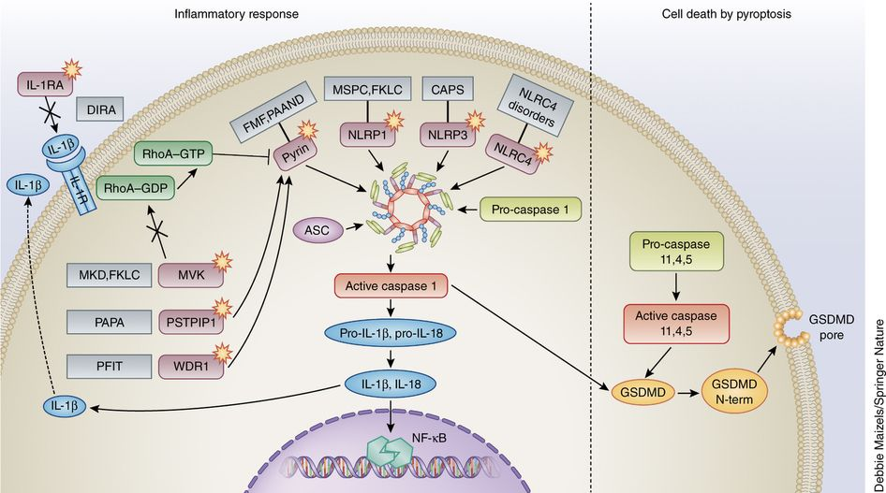
Notes:
*Not Examinable – a basic conceptualization of several periodic fever syndromes: most notable in pediatrics are DIRA, MKD, FMF, CAPS. Many more are not included.

Slide 93
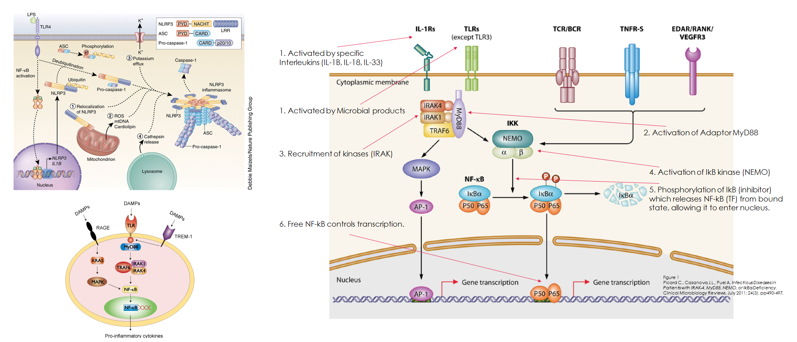
Notes:
Not examinable – for personal reference
LEFT – The inflammasome
RIGHT – the NF-kB pathway

Slide 94
Notes:
Obviously you will never have to learn this; this is just to appreciate the current scope of autoinflammatory disease as we understand it today; likely by this time next ye ar there will be 1-2 more added on.

Slide 95
2.1.18.9.9.
Systemic rheumatologic diseases
General Principles of Fever Syndromes:
  Internal Consistency: every patient will have different manifestations, and some may not even have fevers. The key is that the “episodes” tend to be identical every time. They don’t necessarily need to be like clockwork in schedule (except PFAPA), but in each case the majority of symptoms should be the same.
  Manifestations: common manifestations are fever (usually high grade), rashes, myalgias, conjunctivitis, headaches, and abdominal pain.
  History: the best history you can take is a fever diary. Consider using the AIDAI.
    Always ask for a family history. Most of the time you will be diagnosing the first member in a family, so questions to consider: Sensorineural hearing loss, unexplained renal failure (amyloidosis), childhood tonsillectomy (PFAPA), childhood fevers.
    Demographics / consanguinity.
    Family history suggestive of immunodeficiency.
Notes:
https://autoinflammatorydiseases.org/wp-content/uploads/2015/01/Auto-inflammatory-diseases-activity-index-AIDAI.pdf

Slide 96
PFAPA
Notes:
Main diseases that I think are fair game for pediatrics: FMF, PFAPA, and CRMO. Rest are just to have in the background / future.

Slide 97
2.1.18.9.9.
Systemic rheumatologic diseases
Periodic Fever, Aphthous Stomatitis, Pharyngitis, Rash
The most common periodic fever syndrome of childhood
Unique from the other fever syndromes in several respects:
  Self-limited*
  Exquisitely responsive to single doses of prednisone
  No clear genetic basis*
  Only one that can be managed surgically to resolution*
Notes:
*While the condition is self-limited, there are multiple case reports of patients having it in childhood, resolving (or going into resolution with tonsillectomy) and then having a few years of recurrence in adolescence.
*While there is no defined genetic basis at the moment, it likely has some genetic component to it. I have personal experience in seeing that those heterozygous for MEFV mutations seem to be at increased risk.
*Tonsillectomy will be discussed in a couple slides – it cures almost half of patients and results in marked decrease in symptoms / flares in the rest, though there are a subset of patients who seem to get distant relapses several years later.
MOST COMMON BY FAR

Slide 98
2.1.18.9.9.
Systemic rheumatologic diseases
Manifestations:
  General: age < 5 at onset (typically); episodes are “like-clockwork”; episodes are internally consistent and child is well between episodes.
  Fever: typically high spiking (> 39C); mean duration 2-5 days every 28 days.
  Aphthous ulcers: seen in ~ 70%; non-scarring and last 3-5 days.
  Pharyngitis: seen in ~ 70%; usually erythema/exudate and GAS negative.
  Adenitis: seen in ~ 90%; usually cervical (if generalized, consider malignancy).
  Other: arthralgia, abdominal pain, headaches, malaise.
Investigations:
  May see elevated WBC, ESR, CRP, and elevated IgGAM*
Notes:
Reasons to check labs when considering an autoinflammatory / fever syndrome disorder: to rule out other conditions.
With few exceptions (i.e. HyperIgD syndrome) there is no single diagnostic test during an episode that rules in / out a fever syndrome. One typically expects elevated inflammatory markers and an inflammatory CBC, but this is not always the case. In PFAPA in particular, it is uncommon to see significant elevations in anything but the CRP. Serum Amyloid A (which is not a commercially available test) can be somewhat useful in the other fever syndromes, but lack of availability makes this a challenging test.
The main things you are looking to rule out:
- Cyclical Neutropenia (keep in mind that during a fever / infection episode, the patient may have NORMAL neutrophils that hit nadir just prior to the fever, and then responded as best it could). For this reason you should always check CBC (and while you’re at it, other markers) during and between episodes. Guidelines suggest weekly for 6 weeks, but this isn’t done in routine practice.
- Other immunodeficiency (and therefore infection).
- GAS pharyngitis – until a diagnosis is established, these patients should ALWAYS have a throat swab at every episode. Recurrent infections can mimic PFAPA (may even be on the spectrum).
- Other autoinflammatory diseases – in some severe fever syndromes, labs will improve, but not normalize between episodes. This is a marker of severity and puts them at long-term risk for amyloidosis and renal failure. In PFAPA the labs always normalize between episodes – if they do not, it is NOT PFAPA.

Slide 99
2.1.18.9.9.
Systemic rheumatologic diseases
Diagnosis: clinical diagnosis after more likely/pathologic diagnoses ruled out (especially immunodeficiency, infection, and malignancy).
  Marshall Criteria: initial criteria, though not used religiously (many will make clinical diagnosis based on age and characteristic periodicity of fever). For criteria, should meet all of following:
    Onset of disease in early childhood
    Regularly recurring episodes of fever
    Presence of aphthous stomatitis, pharyngitis, and/or cervical adenitis during flares
    Asymptomatic intervals between flares, with normal growth
    Absence of URTI symptoms during episode
    Exclusion of cyclical neutropenia, other periodic fever syndromes, immunodeficiency, and autoimmune diseases
Notes:
In practicality (and per UTD) all features are not necessary or regularly met. Most important feature is strict periodicity of fever. Key is internal consistency of duration (2-7 days), interval (2-8 weeks), and constellation of symptoms, within same patient. Not uncommon to skip episodes and for trend (with time) for episodes to space out.
Another key feature (not included in criteria) is the rapid resolution of fever and pharyngitis with moderate-high dose of prednisone (1-2 mg/kg), given as single dose or 2 doses 12-48 hours apart.
In addition to patients being well between episodes, they should also have normal inflammatory markers between episodes.

Slide 100
2.1.18.9.9.
Systemic rheumatologic diseases
Management:
  Conservative: PFAPA is not a life-threatening illness; fevers are not harmful medically. A wait-and-see approach may be desired by the parents.
    Ensure that parents are considering best interest of the child. Though the fevers are not medically harmful, the child often misses school and feels miserable. This alone is indication enough for treatment, given the lack of AE with treatment.
    Natural history: most children outgrow over 4-8 years, usually before age 10.
  NSAIDs: anti-inflammatory dosing of Ibuprofen during episodes is safe / effective.
  Steroids: arguably the gold-standard of pharmacotherapy; by definition, PFAPA responds exquisitely well.
    Initial dose 0.6-1 mg/kg q12-24h [at first sign of episode]; can increase to 2 mg/kg.
    In almost all cases, prednisone will abort fever within 24h and markedly diminish the rest of the symptoms (if they develop at all).
    In about 50% of cases, episodes will become more frequent.

Slide 101
2.1.18.9.9.
Systemic rheumatologic diseases
Management:
  Colchicine: rarely used, but in select cases can be given as prophylaxis.
  Cimetidine: used with variable efficacy, mostly in US; fallen out of favor.
  Tonsillectomy: alternate gold-standard in the management of PFAPA
    Cochrane meta-analysis in 2014 of 2 studies demonstrated remission or dramatic reduction in episode severity / frequency.
    4-fold increased likeliehood of becoming symptom-free; in those who do not become symptom free, average interval increases to 2 months-2 years.
Notes:
*Other management point: These patients do not necessarily need to be seen by rheumatology or genetics. This is growing to be considered a disease of general pediatrics.
Reasons to refer:
- Family history of similar symptoms
- Family history of unexplained renal failure, sensorineural hearing loss, or amyloidosis
- Poor / inadequate response to prednisone (i.e. that steroids do not improve episodes)
- Abnormal labwork between episodes / in periods of health
- Very young age (no cut-off, but certainly if age < 1-2 years)
When in doubt the

Slide 102
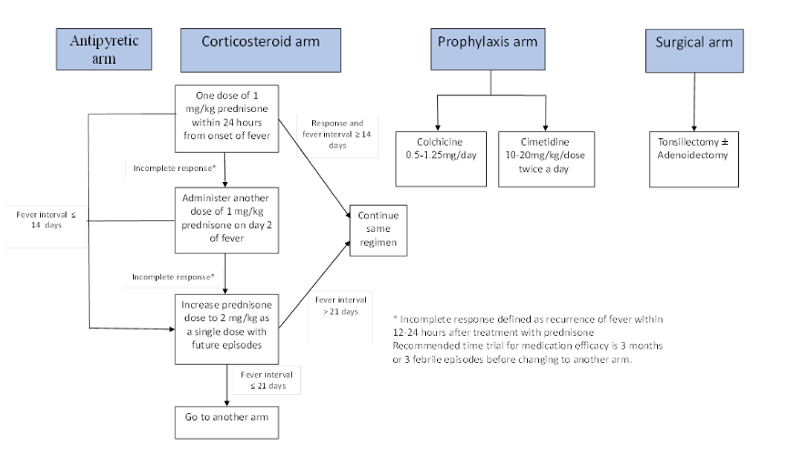
2.1.18.9.9.
Systemic rheumatologic diseases
Notes:
CARRA CTP – you do NOT need to know this, but this is a good frame of reference, particularly the corticosteroid arm.

Slide 103
FMF
Notes:
Main diseases that I think are fair game for pediatrics: FMF, PFAPA, and CRMO. Rest are just to have in the background / future.

Slide 104
2.1.18.9.9.
Systemic rheumatologic diseases
Familial Mediterranean Fever: the most common monogenic fever syndrome
  Autosomal recessive mutations in the MEFV gene on chromosome 16p
  Most common in Ashkenazi Jewish, Arab, Turkish, and Italian populations.
  Onset of disease typically in adolescence or childhood (> 90% start before 20y)
Diagnosis: typically clinical (recurrent short fevers in right demographic, accompanied by abdominal/chest/skin/joint manifestations.
  Tel Hashomer Criteria: diagnosis with > 2 major criteria, or 1 major and > 2 minor:
    Major: recurrent fever with serositis, AA-Amyloidosis without predisposing disease, favorable response to colchicine treatment.
    Minor: recurrent febrile episodes, erysipelas-like erythema, FMF in a first-degree relative.
Notes:
You do not need to learn the diagnostic criteria; that is outside the scope of general pediatrics.

Slide 105
2.1.18.9.9.
Systemic rheumatologic diseases
Manifestations: episodes are typically short (6-72h), occur every 4-12 weeks
  Fever: typically abrupt onset, > 38C, lasting 6-72 hours.
  Serositis: peritonitis >> pleuritis >> pericarditis.
    Peritonitis often severe and can mimic appendicitis; multiple case series.
  Arthropathy: arthralgia or arthritis, typically oligoarticular, usually self-limited but can linger for a few days after episode terminates.
  Myalgia: seen in up to 20%; usually exertional and responsive to NSAIDs
  Cutaneous: a macular, erysipeloid rash is common, usually during fever, most often affecting the foot and leg. May rashes are, however, described.

Slide 106
2.1.18.9.9.
Systemic rheumatologic diseases
Investigations: As before, investigations are mostly to rule out other diseases.
  Inflammatory markers and CBC suggest inflammation; SAA usually high.
  SAA can be elevated between episodes, and is a marker of severity. CRP can also be, but this is quite uncommon in NA populations.
  Genetic testing highly reliable; in practice will often do a gene panel however.
Management:
  Colchicine is the gold standard first line treatment, has extremely few side-effects, and is limited in dosing only by GI intolerance. Marked improvement in 95%, and near-remission in 75%.
  Anti-IL1 Biologics are successful in refractory disease (Anakinra, Canakinumab).
Long Term: life-long disease / treatment; in pre-colchicine era, rate of amyloidosis was ~ 40%, with majority requiring renal transplant by age 40.
Notes:
If untreated will develop amyloidosis and renal transplant

Slide 107
Other Fever Syndromes
Notes:
Main diseases that I think are fair game for pediatrics: FMF, PFAPA, and CRMO. Rest are just to have in the background / future.

Slide 108
2.1.18.9.9.
Systemic rheumatologic diseases
TNF-Receptor Associated Periodic Syndrome (TRAPS): autosomal domintant mutation of the TNFRSF1A gene on chromosome 12, seen in multiple ethnicities but most common in Northern Europeans and Irish populations. Manifests with prolonged fevers (1-4 weeks) of variable intensity, and a distinctive migratory macular erythema with myalgia. Mimics cellulitis. Often also have conjunctivitis, and can have serositis and arthritis.
Hyper IgD Syndrome / Mevalonic Aciduria: autosomal recessive condition of the MVK gene, resulting in decreased synthesis of MK, which results in inability to convert mevalonic acid. Total lack of function results in the metabolic disorder of MA (rarely have fevers; often have neurodevelopmental phenotype). Partial function results in fever syndrome. Onset before 6 months, with moderate fever duration (3-7 days) every 1-2 months. Often accompanied by variable rash, LN/Splenomegaly, and headaches. In spite of name, IgD not specific – diagnosed genetically and (during episodes) by urine organic acid profile showing elevation in level of mevalonic acid.

Slide 109
2.1.18.9.9.
Systemic rheumatologic diseases
Cryopyrinopathies: set of 3 distinct diseases all caused by autosomal dominant mutations in NLRP3 gene.
  FCAS: Familial cold autoinflammatory syndrome; most common; manifests with recurrent, self-limited episodes of (non-prutitic) cold-induced urticaria, fever, arthralgia and (sometimes) conjunctivitis. Onset ~ 1-2 hours after exposure, lasts < 24 hours. Unlike cold-induced urticaria, response is generalized.
  MWS: Muckle-Wells Syndrome; more severe variant; manifests with recurrent fever, (non-pruritic) urticaria, arthralgia, and (sometimes) conjunctivitis. Major distinction is this subset develops SNHL** and has 25% risk of amyloidosis.
    This is extremely important in real life – the SNHL is reversible, if treated early. This single condition is why you always ask about FHx of SNHL. You can diagnose it early and treat and save their hearing for life.
  NOMID: Neonatal onset multisystem inflammatory disorder; most severe; presents in neonatal period as episodic fevers, rashes, severe neurologic disease (meningitis, hydrocephaly, uveitis, optic disc edema, SNHL). Up to 2/3 develop a severe deforming arthritis. Mortality is high.
    Consider this diagnosis in a neonate with refractory, culture-negative sepsis and high CRP.
Notes:
FCAS: Diagnosis: one proposed criteria looks at following 6 features; no cut-off scores [but cohort of genetically confirmed subjects met at least 5 criteria, and none of the unaffected subjects met more than 1 criteria.
Recurrent (intermittent) episodes of fever and rash that are triggered primarily by generalized cold exposure.
Autosomal dominant pattern of inheritance (i.e. affected first degree relatives).
Age of onset < 6 months of age.
Duration of (most) attacks < 24 hours.
Presence of conjunctivitis associated with attacks.
Absence of deafness (MWS), periorbital edema (TRAPS), lymphadenopathy, and serositis.

Slide 110
2.1.18.9.9.
Systemic rheumatologic diseases
DIRA: Deficiency of the IL-1 Receptor Antagonist; relatively newly described fever syndrome that presents in neonatal period, manifesting with multifocal sterile osteolytic bone lesions (which cause pain, irritability, poor feeding). May also develop pustular rashes and fevers. Inflammatory markers high. Can achieve full remission with Anakinra.
DADA2: Deficiency of Adenosine Deaminase 2; relatively newly described autoinflammatory syndrome, this one mimics PAN and results in infantile strokes, along with recurrent fevers and livedoid rash.
Aicardie-Goutieres Syndrome: disease resulting in chilblains, CNS calcifications, and progressive neurodevelopmental decline.
Notes:
From here until we talk about CRMO everything is extremely out of your scope. Just here for future education.

Slide 111
CRMO
Notes:
Main diseases that I think are fair game for pediatrics: FMF, PFAPA, and CRMO. Rest are just to have in the background / future.

Slide 112
2.1.18.9.9.
Systemic rheumatologic diseases
Chronic Recurrent Multifocal Osteomyelitis
  Sometimes referred to as CNO (chronic non-bacterial osteomyelitis) to denote the fact that it is not, necessarily, recurrent or multifocal in all cases.
  Peak age of diagnosis 7-12 years, often with protracted pre-diagnostic phase.
  Associated with several other diseases including:
    Severe acne
    Psoriasis
    Spondyloarthropathy
    IBD
  May be a limited phenotype of SAPHO, and adult diagnosis with similar lesions.
Notes:
SAPHO = Synovitis, Acne, Periostitis, Pustulosis (palmoplantar), Hyperostosis, Osteitis.

Slide 113
2.1.18.9.9.
Systemic rheumatologic diseases
Manifestations: Bone pain or pathologic fracture (less often, incidental).
  Bone lesions are most common in the tibia, fibula, femur; less common (though still > 20%) and more specific are pelvis, clavicle, and mandible.
  Bone lesions can present as unifocal or multifocal; in the world of whole body scans, it is not uncommon to find additional asymptomatic lesions.
  Bone lesions in the vertebrae often present as pathologic compression fracture (unless they are picked up incidentally).
  Some patients may have constitutional symptoms and low grade fevers; however, these patients unequivocally need to be seen by oncology and orthopedics, and have a histologic evaluation for malignancy.
Notes:
Recall that bone pain is typically characterized by a progressive, insidious, focal area of pain – usually this area is warm and tender to touch, and tends to be worse at night.

Slide 114
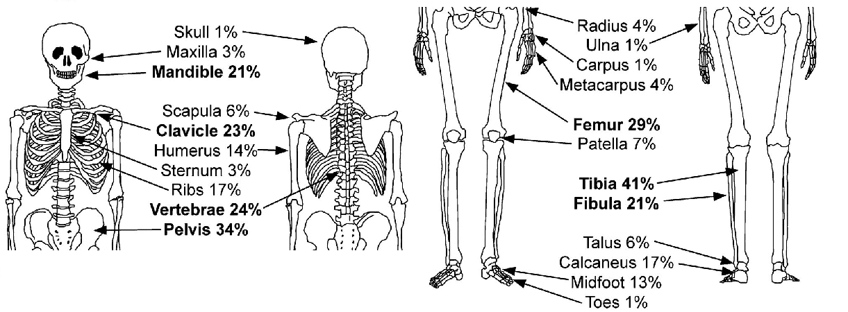
2.1.18.9.9.
Systemic rheumatologic diseases

Slide 115
2.1.18.9.9.
Systemic rheumatologic diseases
Imaging: lesions can be seen on any modality.
  Plain Films: shows a mixed osteolytic and sclerotic lesion (though goes through phases) with cortical thickening; occasionally see periosteal reaction. Can be indistinguishable from leukemia. Will evolve over years.
  Bone Scan: lesions always have increased uptake and this is an excellent modality to pick up asymptomatic sites.
  MRI: local MRI is the gold-standard to diagnose CRMO on imaging; whole-body MRI is used in selective institutions in Canada (including Calgary) to identify asymptomatic sites.
There is debate as to whether it is necessary to look for asymptomatic sites. Most people would agree that checking the spine is critical, as presence of lesions here often indicates more aggressive therapy. Other treatments are all systemic, so argument to be made for less investigation.

Slide 116
2.1.18.9.9.
Systemic rheumatologic diseases
Investigations:
  Labs: typically have elevated ESR, CBC, +/- platelets. Mainly look for cytopenia to help in evaluation for malignancy.
  Histology: it is not uncommon for a bone biopsy to be required in these patients to definitively rule out infiltrative and primary bone tumors. Clinical criteria have been developed to help save on biopsies. In general the things that make CRMO more likely than malignancy or infection are:
    Presence of multiple, non-contiguous lesions.
    Presence in the clavicle or mandible.
    Particular radiographic features (marginal sclerosis).
    Normal CBC and elevated CRP.
    Absence of a fever.

Slide 117
2.1.18.9.9.
Systemic rheumatologic diseases
Differential Diagnosis: this the most likely thing they will test you on.
  Infection: osteomyelitis (particularly chronic – TB, etc…)
  Malignancy: leukemia, osteosarcoma, Ewings, LHC
  Other: Hypophosphatasia, Immunodeficiency (CGD)

Slide 118
2.1.18.9.9.
Systemic rheumatologic diseases
Management:
  NSAIDs: at anti-inflammatory doses this is first-line therapy for CRMO. Not clear it necessarily modifies the natural history, but most people advocate for chronic use. Provides relief in > 80% of patients. Variable remission rates in studies.
  Immune Modulation: variable degree of evidence for induction of remission with sulfasalazine, methotrexate, and TNF inhibitors.
  Bisphosphonates: approaching the gold-standard of care, with protocols developed by local expertise and now used worldwide. Pamidronate preferred. Multiple protocols. Main indications are for vertebral lesions, or refractory pain.
Natural History: in a single lesion, the process (from onset to radiographic resolution) takes ~ 3 years. There are a subset who have chronic disease.

Slide 119
Non-Rheumatologic MSK Diseases
Notes:
Practical / Real life information: Though I am teaching this, these diseases are NOT rheumatologic, and are NOT followed by rheumatology. The diagnoses of Marfan syndrome, Ehlers Danlos, and Skeletal dysplasia are all made by genetics, to whom the patient should be referred. The wait list is quite long, however, and practically speaking these diseases can be diagnosed easily by the general pediatrician. Generalized hypermobility is also a disease of general pediatrics, and does not require a rheumatology referral. They can and should be managed by physiotherapy.

Slide 120
Marfan Syndrome

Slide 121
2.1.18.3. non-inflammatory connective tissue diseases
The prototypic inherited connective tissue disease.
**There is an AAP Article on this**
Epidemiology: the most common inherited connective tissue disease.
  Incidence ~ 1 : 5000-10000 live births
Etiology: caused by an autosomal dominant mutation in Fibrillin-1 (FNB1).
  75% of cases are inherited directly; 25% are de novo mutations.
Notes:
**Health Supervision for Children with Marfan Syndrome

Slide 122
2.1.18.3. non-inflammatory connective tissue diseases
Clinical Manifestations:
  Cardiovascular: aortic root dilatation is the most common manifestation, and the most common cause of morbidity and mortality. ~ 50% develop in childhood and over 80% lifetime risk. High risk of aortic root dissection.
    Second-most common manifestation is mitral valve prolapse; ~ 40% lifetime risk.
    Less commonly can affect more distal segments of the aorta, particularly abdominal.
  Ocular: ectopia lentis (superior dislocation of the lens) is the most common and pathognomonic feature of MD, manifesting as quickly progressive myopia. Even without this, MD patients often have myopia due to shape of eye.
  MSK Features: many; the key features are a “marfanoid” habitus of tall stature, long limbs / fingers, with multiple deformities.

Slide 123
2.1.18.3. non-inflammatory connective tissue diseases
Diagnosis with the "Modified Criteria" are more clinical, classified based on presence or absence of parent with the disease.
  Negative FMHx: root dilatation PLUS extra criteria (ectopia lentis, FNB-1 mutation, systemic score > 7).
  Positive FMHx: aortic root dilatation OR ectopia lentis OR systemic score > 7.
Non-MSK Features:
  Spontaneous pneumothorax.
  Dural ectasia (widening of dural sac around spinal cord).
MSK Features:
  Arachynodactyly (manifests as positive wrist sign and positive thumb sign).
  Chest wall deformity (pectus kerinatum, pectus excavatum).
  Foot deformity (hindfood deformities, pes planus).
  Spine deformity (scoliosis, kyphosis).
  Facial features (dolicocephaly, enophthalmos, malar hypoplasia, downslanting fissures, retrognathia).
  Other (reduced elbow extension, protucio acetabulae, long limbs [low US:LS ratio, high AS:ht ratio]).
  Skin striae (not better explained by something else).
Notes:
Each of these is worth a certain number of points to calculate a systemic score. You will not need to learn the score, just know you can google and use an online calculator to get a systemic score. I doubt you will be asked the exact ratios for the spans, just know that typical is a Low US:LS ratio (reflecting that they have long legs) and a High AS:height ratio (reflecting that they have long arms).
Note that the wrist sign and thumb sign are NOT features of hypermobility (people often get this wrong, clinically). They are features of arachnodactyly. The most limber person cannot do a proper “wrist sign”.
The key features above I would attempt to commit to memory (if not now then for the OSCE) which are highest yield are:
- Pneumothorax
- Arachnodactyly [the thumb and wrist signs]
- The “Marfanoid habitus” [the two ratios]
- Spine and chest wall deformities

Slide 124
2.1.18.3. non-inflammatory connective tissue diseases
Management: general principles are below. The AAP has an exhaustive summary which I have synthesized in the “notes” section.
  Cardiac Assessment: when suspecting MD, patient requires an echocardiogram. If a diagnosis is made, echocardiogram is done at least annually.
  Ophthalmologic Assessment: when suspecting MD, patient requires eye exam, and if a diagnosis is made, annual (or q6 monthly) follow-ups.
  Anticipatory Counselling: counsel them on symptoms of pneumothorax and above, to know they should seek care.
  Family Counselling: if patient is formally diagnosed, particularly with genetic diagnosis, should be sent to genetics and all first degree relatives should have echocardiogram pending genetic testing.
Notes:
The AAP recommendations are as follows:
Birth: cardiac examination / Echo, full examination (clinical, measure all ratios) and eye exam (red reflexes).
Refer to pediatric ophthalmologist in neonatal period to evaluate for lens laxity in confirmed cases.
While cardiac manifestations are rare, echocardiogram should be done at baseline.
Review of diagnosis, examine family to make diagnosis in them, offer referral to support groups etc...
Infancy: cardiac examination (clinical) and full exam (clinical, measure all ratios) and anticipatory guidance.
If normal baseline echo has been obtained, no need to repeat until at least 1 year of age.
Ophthalmology is not as critical early on as typically lens dislocation develops over the course of years.
Should be continuing to review surgical risks with connective tissue disease.
Childhood: echocardiogram (q1y starting at age 1y), routine eye exam (ophthalmology) and MSK examinations.
Anticipatory guidance should include avoidance of strenous exercise / contact / competitive sports where possible, use of protective eyewear, and symptoms of spontaneous pneumothorax.
Late childhood: continue routine echo, ophthalmology, and skeletal examination.
Note that puberty can drastically affect the height and segment ratios, so be aware to watch for complications of rapid limb growth (pain, fractures, etc...).
Anticipatory guidance to child now includes signs of dissection (chest pain etc...) in addition to pneumothorax, participation in sports, working-out etc...
Should consider bone age to consideration use of hormonal methods to advance puberty enough to prevent further progression of linear height.
Adolesence: Continue routine echo, ophthalmology, and skeletal examination.
In addition to above, anticipatory planning now includes reproduction / contraception and heritability.
The AAP recommendations are tricky: their table states the above, but their physical handout seems to mention that echocardiogram is only needed at birth then again at 13 years of age (and similar for ophthalmologic assessment).

Slide 125
Ehlers Danlos Syndrome

Slide 126
2.1.18.3. non-inflammatory connective tissue diseases
Heterogeneous group of disorders [currently 11 + 8 subtypes] with fairly disparate manifestations and genetics.
  Type I: is the classic, severe form that manifests with severe joint laxity, easy bruising, and poor wound healing (caused by mutation in COL5A1)
  Type III: is the most common (and irritating) form, causing generalized hypermobility. This is the one most commonly thought of when discussing EDS. Multiple genes implicated, none with any consistency.
  Type IV: the vascular (and severe) subtype that results in vessel and bowel wall rupture, translucent skin, and mortality (mutations in COL3A1 or COL1A1)
Remaining slides pertain exclusively to Type III
Notes:
If you are asked about EDS, the likeliehood is 99% that they are referring to one of the 3 types above, and most often they are referring to Type III. They will not expect you to know the numbers and types. Just be aware that there is an early onset vascular form that causes the severe viscous ruptures and translucent skin, there is the “classic” form that causes the thin skin, joint laxity, easy bruising, keratotic scars, etc… and then there is the one that causes hypermobility and either nothing else, or very mild features of the “classic” type.

Slide 127
2.1.18.3. non-inflammatory connective tissue diseases
Assessment: the key thing you are attempting to delineate is as follows:
  Do they have hypermobility, or is there another cause for their symptoms?
  If they are hypermobile, are they so hypermobile they are developing other complications (i.e. dislocations)?
  Are they exhibiting other features of connective tissue disease (involving the skin, usually) in addition to their hypermobility (if present)?
History: mostly pertains to the above – specifically ask about dislocation, sprains, and injuries. Don’t forget family history and infantile history.
Physical Exam: primarily trying to rule out other pathology (tarsal coalition, inflammatory arthritis) and to establish hypermobility using Beighton Score.
Notes:
I’m not sure if Beighton score is examinable now or on OSCE, but this is extremely important in general and I highly recommend you learn it. It will be more useful to you clinically than the Marfans assessments.

Slide 128
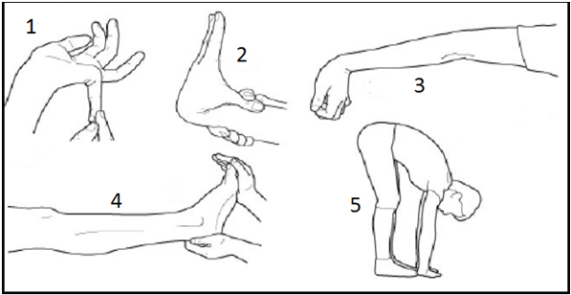
2.1.18.3. non-inflammatory connective tissue diseases
Notes:
Total possible score = 9
Extension (passive) of 5th MCP >= 90 degrees (1 point each hand)
Flexion of wrist + abduction of thumb (passive) to reach the forearm (1 point each hand)
Hyperextension of elbow to >= 10 degrees (1 point each elbow)
Hyperextension of knees to >= 10 degrees (1 point each knee)
Ability to lay palms flat on floor with knees kept straight
It is important to know that the Beighton score is not the be all and end all of hypermobility assessment.

Slide 129
2.1.18.3. non-inflammatory connective tissue diseases
In adults, Type III EDS can be diagnosed by the presence of hypermobility (Beighton score > 6/9) and at least 2 of the following 3 categories of features:
  (A) systemic manifestations of CTD [soft skin, hyperextensible skin, unexplained striae, bilateral piezogenic papules of heel, recurrent abdominal hernias, atrophic scarring, pelvic/uterine/rectal prolapse, dental crowding/high arched palate, arachnodactyly, high AS:h ratio, MVP, aortic root dilation)
  (B) positive family history [first-degree relative with formal diagnosis of EDS].
  (C) MSK complications [MSK pain in 2 or more limbs daily for > 3 months, chronic widespread pain for > 3 months, recurrent joint dislocation / instability in the absence of trauma].

Slide 130
2.1.18.3. non-inflammatory connective tissue diseases
Benign Joint Hypermobility: this condition is essentially the term favored for adolescents or children with hypermobility who do not have the features of EDS. Marks the end of a normal flexibility spectrum.
  Different sources use different Beighton cut-offs ranging from 4-6.
  The Beighton, notably, is not the be-all and end-all of assessment. It does not look at every joint. The bones, ligaments, and tissues all grow and mature at different rates, and children can have pain in a few joints.
  Best way to assess this is to check the Beightons, but also do a full joint exam and attempt to appreciate whether there is relative hypermobility.
Management: treatment for this and EDS type III are the same – physiotherapy and pain control. Prefer pediatric phyiostherapy.
Notes:
Your role as the pediatrician: to rule out other conditions that are causing joint pain. A rheumatologist is not, always, necessary for the management of these conditions. We do not follow them, we simply rule out JIA – in practice the most common mimic is ERA. Remember the key ways to distinguish mechanical pain from inflammatory (arthritis) pain:
- Inflammatory pain (as in JIA) is typically worse in the mornings, improves with activity / worsens with rest, and is associated with stiffness. Critically, it is very rare for JIA to result in “pain everywhere”. Recall that JIA tends to have patterns: oligoarticular (affecting a few large joints, asymmetrically, usually knees, wrists, and ankles), polyarticular (symmetric pain and stiffness in the hands / feet and neck, sparing the back + hips + shoulders), and ERA (usually associated with morning back pain and stiffness, plantar fasciitis-type symptoms, and focal areas of tenderness at the entheses and nowhere else).

Slide 131
2.1.18.3. non-inflammatory connective tissue diseases
Fibromyalgia: a term that is used with variability in pediatrics; depending on school of training, may refer to it as central sensitization, functional pain syndrome, or diffuse idiopathic widespread pain.
  All terms means the same: the patient has diffuse, non-organic mechanical pain.
  We no longer use trigger points in diagnosis (though picture attached).
  The key way to delineate this from joint hypermobility or JIA is by physical exam:
    People with FM are tender pretty much everywhere – over joints, entheses, bones, muscles, all with varying degrees.
    The “stress muscles” always seem more affected – i.e. the neck and shoulders.
  As a “functional” syndrome, it often occurs alongside anxiety/mood disorder, recurrent headaches, chronic abdominal pain, and dysmenorrhea.
  Management is with a multidisciplinary team, management of comorbid mental health issues, sleep management, and a regimented health / exercise program.
Notes:
For fibromyalgia the first encounter is the most important. You play a key role in the family accepting or declining this diagnosis:
- If you suspect FM, even if you are not sure, you should let the family know that non-organic pain is on the differential while you do the work-up. As tempting as it is, if you let them think there is an organic disorder until you rule it out, you give them time to seethe in denial. The patient also becomes more withdrawn and does less activity, which worsens pain.
- Irrespective of whether there is another diagnosis you ultimately find, the things that make FM worse (untreated anxiety/depression, poor sleep, lack of exercise) also make all kinds of organic pain worse – for that reason you should make these conservative e recommendations to all patients with pain irrespective of cause (short of there being a clear fracture).
- Many family doctors tell their patients to hold off on gym / activity until they rheumatology – DO NOT DO THIS – just think: what diseases am I attempting to manage by telling patient to hold off from activity. 99% of the conditions can be ruled out within 24 hours with plain films, and the rest will improve with activity or be no worse. In fact, if pain is worsening with activity, it is increasingly likely to be functional.

Slide 132
2.1.18.3. non-inflammatory connective tissue diseases
There are literally dozens of other “connective tissue” diseases or metabolic / genetic conditions that can mimic them. You do not need to learn them (as far as I know) but in the notes section is just a small list that I learned for my rheumatology exam. Can keep for future reference.
Notes:
Stickler Syndrome: covered in previous section, his AD/AR disorder related to mutation of Collagen genes [COL2A1 >> COL9A1, STL4]. It is characterized by progressive osteoarthritis (15% by age 20), severe SNHL, and high myopia leading to retinal detachments. The sensory component is what distinguishes it from the MED skeletal dysplasias. Other MSK features include hypermobility, kyphoscoliosis, pectus carinatum, genu valgum, arachnodactyly, and craniofacial features including cleft lip / palate.
Kniest Syndrome / Spondyloepiphyseal Dysplasia Congenita: these are AD disorders from mutation in COL2A1 (which is also involved in some forms of Stickler syndrome). Kniest characterized by congenital shortening of limbs and trunk, macrocephaly, hip dislocation, kyphoscoliosis, cleft palate, myopia with retinal detachment, SNHL, and enlargement of the joints [resembles Stickler]. SEDC manifests with congenital joint stiffness, short stature, foot deformities (club feet), and severe hip problems. Occasionally immunodeficiency has been reported.
Congenital Contractural Arachnodactyly: this is related to AD mutations of Fibrillin Type II, and manifests with congenital contractures of knees / elbows / PIPs that can improve with time and PT; later on can resemble Marfans, with accelerate growth velocity and long limbs, and occasionally aortic root dilatation.
Homocystinuria: covered in previous section, this AR mutation of the CBS gene manifests with a Marfanoid body habitus, but inferior myopia (and downward lens dislocation), hypotonia, joint stiffness (not laxity), and later, thromboembolic disease.
Melorheostosis: a rare, idiopathic, sclerosing bone disease that also causes tight, bound-down skin (resembling scleroderma). Can be associated with intermittent joint pain / swelling, asymmetric growth, Raynaud phenomenon, vascular anomalies, and contractures. Characteristic feature on radiograph is endosteal hyperostosis (later becoming periosteal).
Arthritis Mimics: several disorders can mimic JIA (while instead being connective tissue disease). Some can even have elevated ESR, morning stiffness, and improvement with NSAIDs. Distinguishing features are a positive family history, consanguinity, absence of antibodies, symmetrical pattern, or with multiple organ involvement.
Dysostosis Multiplex: categorizes multiple storage disorders (such as mucopolysaccharidoses, mucolipidoses, mannosidosis, fucosidosis, etc...) all of which result in abnormal accumulation of said product due to enzyme deficiency. They variable include corneal clouding, dwarfism, intellectual disability, coarsened features, joint effusions / stiffness, and skeletal dysplasia. Importantly, several have ERT interventions that can salvage phenotype.
Mucopolysaccharidoses: genetic deficiencies of enzymes involved in metabolism of glycosaminoglycans. Manifest with progressive skeletal dysplasia, coarsening of facial features, and corneal clouding. Contractures of the hand due to thickening of skin (from accumulation) is an early sign. The most well known examples are Hurler Syndrome (Type I), Hunter Syndrome (Type II), and Sanfilippo Syndrome (Type IIIA). The lesser known phenotypes of Morquio Syndrome and Scheie Syndrome can mimic JIA particularly well, as they have only mild dysostosis, with significant diffuse MSK stiffness and oligoarticular effusion. Several joints may be enlarged. Skeletal findings can often be seen. Coarsening is variable and ESR is usually normal.
Mucolipidoses: genetic deficiency of enzymes involved in metabolism of sphingolipids and glycosaminoglycans, distinguished from above because there is no alteration in urinary glycosaminoglycan excretion. Collectively all 4 subtypes manifest with a spectrum of progressive neurologic and ocular disorders, occasionally with skeletal abnormalities like short stature.
Diastrophic Dysplasias: disorders characterized by short limbs, small chests, enlarged joints (especially knees), and skeletal abnormalities (sandle toe gap, radial dislocation, hitchhiker thumb). They can get fracmentation and calcification of cartilage, leading to swelling / effusions, and eventual fusion in joints like the hands. Calcification of cartilage also occurs in ears, trachea, and chest.
Progressive Pseudorheumatoid Arthropathy: a rare AR disorder presenting in children 3-8 years old, due to mutations in WISP3 gene. Progressive disorder manifesting with joint stiffness / swelling, abnormal gait, weakness, joint space narrowing, and periarticular osteopenia (eventually leading to metaphyseal enlargement, contractures, and kyphoscoliosis). Scheuermann phenotype may be present. Lab features of JIA are absent.
Camptodactyly-Arthropathy-Coxa Vara-Pericarditis (CACP) Syndrome: an AR disorder manifesting with features in name; trigger finger (camptodactyly) is often congenital; arthropathy with significant synovial hypertrophy presents in childhood, and serositis may be severe enough to warrant intervention. In addition to coxa vara, large synovial cysts can often be seen. This is due to a mutation in genes coding proteoglycan-4 (lubricin).
Trichorhinophalangeal syndrome: AD disorders due to mutations in TRPS1, manifesting with craniofacial and skeletal abnormalities (bulbous nose, short stature, short metacarpals / metatarsals, fragmented femoral heads mimicking LCP). Can also be associated with multiple exostoses.
Skeletal Dysplasias
Definition/Classification: collectively, the term refers to disorders of the connective tissues that alter the appearance of the radiographic skeleton.
There are currently > 400 conditions, divided into 40 groups, based on molecular, biochemical, and radiographic criteria.
These include the metaphyseal dysplasias, multiple epiphyseal dysplasias, osteogenesis imperfectas, and more.
Diagnosis: requires careful review of prenatal, perinatal, postnatal, and family history, along with detailed anthropometrics and physical exam (in order to compare phenotype to OMIM etc...)
Clinical Features: dysmorphic features, extremity abnormalities, scleral hue, short stature, etc... are all reasons to consider a skeletal dysplasia.
Diagnostic Imaging: the crux of diagnosis - a skeletal survey (lateral skull, lateral T/L spine, thorax, pelvis/hips, long bones, and hands) is required in most patients.
Typically a pattern of abnormalities can be given (epiphyseal, metaphyseal, diaphyseal, or spondylo- abnormalities).
Timing is important; characteristic radiographic features may not be present early, and others may be lost following skeletal maturity.
Advanced imaging is rarely required for diagnosis; however, can help with evaluating complications (i.e. spinal cord compression).
Combined with clinical features, imaging is often enough to provide a diagnosis without additional testing.
Labs: biochemical testing important to consider - rule out rickets, mucopolysaccharidoses, mucolipidoses, and chondrodysplasia punctata.
Histology: rarely necessary, and most often done as part of autopsy (or in OI to assess response to bisphosphonates). Marrow biopsy can be assessed as surveillance for those linked to malignancy (i.e. Cartilage hair hypoplasia, Schwachman-Diamond).
Genetics: molecular genetics is, for the most part, the gold standard of diagnosis if a gene is found; however, clinical diagnosis is triumphant as genetics can be normal in many conditions.
Management Principles: some diseases have specific treatment (i.e. osteopetrosis and HSCT) but for the most part these gene-based therapies are ineffective in skeletal dysplasia.
In general try to pharmacologically correct physiologic abnormalities (i.e. vitamin D supplementation, bisphosphonates).
Rehabilitation is the core of treatment, to manage pain and correct abnormalities where possible.
Surgery plays a major role in correcting progressive complications of skeletal dysplasias, though unfortunately relapse rate is high. Procedures range from scoliosis surgery to joint replacement.
Other specialists are key (ophthalmologists, ENT, endocrinologists) depending on subtype and associations.
Multiple Epiphyseal Dysplasia
A prototype of skeletal dysplasia, it shares overlapping anomalies of physeal / epiphyseal development. Describes a group of conditions (MED 1-6, familial OCD, recessive Stickler syndrome, familial hip dysplasia, and Lowry-Wood syndrome).
Classification: characterized by abnormal development of the epiphyses of the appendicular skeleton, with mild or no visible changes in the axial skeleton.
Etiology: various genetic disorders fall into this class (see above) with gene mutations in COMP, COL9A1-3, DTDST, MATN3, and AGC1 genes. Depending on condition are either AD or AR inheritance.
AD forms are more common in general in this category. Most common AR form is MED4.
Genetic testing only identifies about half of patients in this category, so diagnosis is very much clinical.
Manifestations:
AD Forms tend to appear normal at birth (aside from relatively short / broad hands and feet); in early childhood there is a slowing of growth velocity, genu valgum, and pain in hips and knees. Skeletal survey done at this stage may reveal multiple epiphyses with abnormal development and shape, including the femoral heads (which often have multiple ossification centers that give the appearance of LCP). Vertebrae often normal, or have mild endplate irregularity. Some subtypes will also have ligamentous / joint laxity and mild myopathy, vertebral abnormalities, or proximal muscle weakness. All forms develop progressive skeletal impairments (genu valgum, lateral hemiepiphysiodesis of knee, progressive OA).
AR Forms (specifically MED-4) have congenital abnormalities manifesting as club feet, and will later develop features of MED. In addition to features above, may also develop recurrent patellar subluxation / dislocation, and a unique finding of a "double-layered patella". Femoral heads are severely affected, with early OA and need for joint replacement in second or third decades of life.

Slide 133
Review
2.1.18.1. Anatomy, structure and function of bone, joint and connective tissues, normal and abnormal
2.1.18.2. Physiology of normal bone growth and function
2.1.18.3. Recognition of non-inflammatory connective tissue diseases, e.g. Marfan's syndrome, Ehlers Danlos syndrome
2.1.18.4. Mechanisms of immune responses in rheumatic disease
2.1.18.5. Indications for, and interpretation of laboratory tests on blood and synovial fluid
2.1.18.6. Pharmacology of common anti-inflammatory drugs, corticosteroids and immunosuppressive drugs
2.1.18.7. Effects of chronic rheumatic diseases on physical growth and social development
2.1.18.8. Common radiographic abnormalities in musculoskeletal diseases
2.1.18.9.1. Congenital abnormalities
2.1.18.9.2. Joint and limb pain
2.1.18.9.3. Common fractures, dislocations or injuries
2.1.18.9.4. Joint deformities
2.1.18.9.5. Septic arthritis and osteomyelitis
2.1.18.9.6. Common gait disorders (limp, torsional and angular deformities of lower limbs)
2.1.18.9.7. Scoliosis
2.1.18.9.8. Acute / chronic arthritis
2.1.18.9.9. Systemic rheumatologic diseases, e.g. systemic lupus erythematosis, juvenile idiopathic (rheumatoid) arthritis
2.1.18.9.10. Bone tumors

Slide 134
Specific Questions that we definitely did not get from old exams because that would be wrong and we aren’t allowed to do that, right guys?
Remember: in all likeliehood the questions you are struggling to find answers for are mis-remembered. Alternatively they were poorly written “test” questions, and their Ankgoff score would not hit the cut-off to be rated.
There were no questions I can recall on my exam that were as poorly worded or confusing as any question we are about to discuss.
I mean, other things – I’m not discussing my exam because I’m not allowed to…

Slide 135
Specific Questions that we definitely did not get from old exams because that would be wrong and we aren’t allowed to do that, right guys?
Most likely this is a RLL pneumonia (an answer in other iterations). The main hint seems to be the lack of guarding in the abdomen.
“FM” likely stands for “FMF” as seen in other iterations – this is a serositis / peritonitis, and would cause guarding.
The “Greek” is likely there to throw you off.
A 6 year old Greek girl presents with a high fever, tachypnea, and RUQ pain. On exam, there is no guarding in the abdomen. What is the most likely diagnosis?
a. Bacterial pneumonia
b. Pleurodynia
c. FM

Slide 136
Specific Questions that we definitely did not get from old exams because that would be wrong and we aren’t allowed to do that, right guys?
Again a difficult question because we don’t know when it was written first, and we don’t know the other answers.
From the actual diagnostic criteria (from the 70’s) MRI is not included, even though it is the gold standard.
Muscle biopsy would be the best answer if it is asking for “best” test.
Between these two, EMG is more specific and sensitive, so pick it. CK can be up in many conditions, and in severe JDM may not be elevated. In most severe cases they have burned away so much muscle they have none left to produce a CK.
Girl with JDM, what is the best diagnostic test
a) EMG
b) CK
Notes:
Biopsy – Mri- EMG – CK

Slide 137
Specific Questions that we definitely did not get from old exams because that would be wrong and we aren’t allowed to do that, right guys?
The questions that discuss priority are always challenging – often you are deciding between practicality and accuracy.
Because of the presence of fever, B and C are definitely wrong. This is a case of septic arthritis until proven otherwise.
I would choose D. Because of the age and presentation, I would want coverage as I am working up, knowing that yield of aspirate is 60% overall. A is not wrong however, and could be done simultaneously in practice.
2 year old has fever of 40 degrees and is irritable. He refuses to move his left hip. What is the first thing you do?
a. Aspirate the left hip with needle
b. X-ray
c. Bone scan
d. Admit, do blood culture and start antibiotics

Slide 138
Specific Questions that we definitely did not get from old exams because that would be wrong and we aren’t allowed to do that, right guys?
This is trying to make you think of PANDAS. This is hard… because Nelsons itself disagrees.
  In the psychiatry chapter there is a small section about it being an organic cause of tic disorders.
  In the ID section, they say it’s not real.
  It may be a form of autoimmune encephalitis (per Susa).
Based on this, the answer is B. They are unlikely to give you a red herring like pharyngitis.
It is not Rheumatic fever – this is not Syndenham Chorea.
Boy with recurrent pharyngitis. Episodic jerking of shoulders and head over past 6 weeks. Most likely diagnosis?
a. Rheumatic fever
b. Transient tic disorder
c. Tourettes
d. Some sort of seizure disorder
Notes:
Key Features of Syndenham Chorea: jerky movements of face / extremities / trunk, absence during sleep, "wormian" tongue that darts about, halting / explosive speech [irregular tone], pronation during arm raise, milkmaids grip [constant contractions during sustained grip], irregular / poor drawing and writing, difficulties with fine motor tasks, emotional lability [frustration more than primary inflammation].

Slide 139
Specific Questions that we definitely did not get from old exams because that would be wrong and we aren’t allowed to do that, right guys?
Of these the most likely is SLE (A).
Main reason is the elevated ESR.
  As an interesting learning point, ESR is elevated in active lupus disease (and flare), CRP suggests either serositis (from SLE), infection, or MAS. Both being raised often means you have active SLE being triggered by infection, causing serositis, or causing MAS.
Not B because they state arthralgia and they don’t define fever. I’d imagine if you are to answer sJIA you’d be given a clear picture of quotidien.
Not C because of only trace protein and blood, and you should NOT have fever with this (it’s POST-strep, so your infection is passed long ago).
12 yo girl – fever, malaise, arthralgia for 3 weeks. ESR 50, WBC 3 (leukocytes 10%, neutrophils 90%). Trace proteinuria/hematuria. BUN/Cr normal. What is your diagnosis?
a. lupus
b. systemic JIA
c. PSGN
Notes:
ESR is best for lupus: HIGH ESR, low CRP typically

